Slide 1

Daily Challenge - PE and Maths #6
This PE and Maths challenge card has been created to help keep your mind and body active using a quick and fun challenge!
The card is suitable for KS1 to KS3 (ages 6 to 12) to develop or reinforce numeracy skills linked to physical activity.
The aim of the challenge is to:
(Physical) Complete a number of sprint shuttle runs
(Mathematical) Calculate the sums as quick as possible using mental arithmetic
The rules are:
Choose and create a shuttle run course (Distance and lay out up to you)
Choose Level 1 (Easier sums) or Level 2 (Trickier sums)
Answer the sum-Record on sheet or your own version
Run the answer number of shuttles around your course
Extensions: 1. Change your course or increase the distance
2. Measure your course and work out total distance covered
(Distance x total number of shuttle runs complete)
3. Make up your own sums
4. Add a skill (dribble a football, bouncing a ball etc)
For more home learning resources, visit www.pescholar.com/home-learning

Slide 2
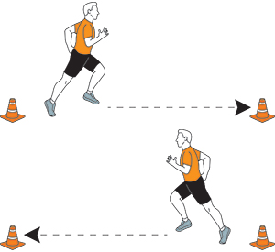
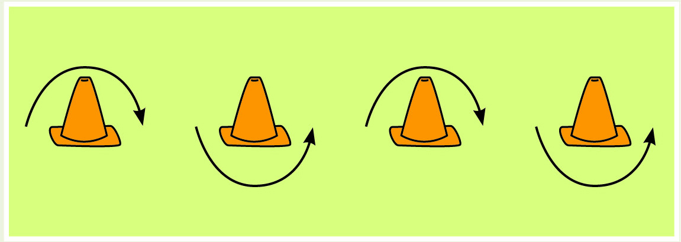
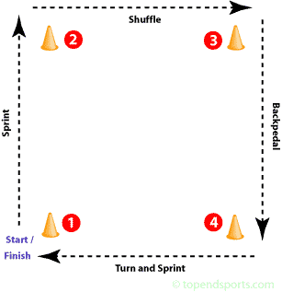
Daily Challenge - PE and Maths #6
Quick Maths-Speed and agility
Choose and set up your course
Maths Question |  | Your answer and Your number of shuttle runs
Level 1 | Level 2
3 x 4 ÷ 2 | √4 + 1
(3+1) x 2 | (12 x 4) ÷ 8
2 + 3 + 2 | √16 - √4
10 ÷ 5 - 1 | 42 ÷ 6
9 ÷ 3 | (2 + 3) x (8 – 7)
7 x 1 - 3 | 100 ÷ (5 x 5)
2 x 3 - 2 | 2.8 + 2.2
(10 – 6) + 2 | (21 ÷ 3) - 3
For more home learning resources, visit www.pescholar.com/home-learning

Slide 3
Daily Challenge - PE and Maths #7
This PE and Maths challenge card has been created to help keep your mind and body active using a quick and fun challenge!
The card is suitable for KS2 to KS3 (ages 8 to 14) to develop or reinforce numeracy skills linked to physical activity.
The aim of the challenge is to:
(Physical) Complete a number of sprint shuttle runs
(Mathematical) Calculate the word problem sums as quick as possible using mental arithmetic and general knowledge
The rules are:
Choose and create a shuttle run course (Distance and lay out up to you)
Answer the sum-Run the answer number of shuttles around your course
Extensions: 1. Change your course or increase the distance
2. Measure your course and work out total distance covered
(Distance x total number of shuttle runs complete)
3. Make up your own sums
4. Add a skill (dribble a football, bouncing a ball etc)
For more home learning resources, visit www.pescholar.com/home-learning

Slide 4
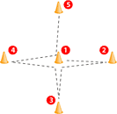
Daily Challenge - PE and Maths #7
Math Problems -Speed and agility
Choose and set up your course
Math Problem | Your answer and Your number of shuttle runs
Number of days in May minus number of days in February (non leap year)?
Number of Kings and Aces in a standard pack of cards?
12 degrees colder then 17 degrees?
7 degrees hotter then -2?
Number of weeks in a year divide by 13?
£1 minus 3 x 20p, 5 x 5p and 2 x 2p?
The number of minutes difference between 2.57pm and 3.03pm?
The highest number you can roll on an ordinary dice minus the lowest number you can roll?
For more home learning resources, visit www.pescholar.com/home-learning

Slide 5
Daily Challenge - PE and Maths #8
This PE and Maths challenge card has been created to help keep your mind and body active using a quick and fun challenge!
The card is suitable for KS1 to KS3 (ages 6 to 14) to develop or reinforce numeracy skills linked to physical activity, with a focus on estimating in 60 seconds.
The aim of the challenge is to:
(Physical) Complete a 5 stage work out
(Mathematical) To use gained knowledge to estimate an activity for 60 seconds
The rules are:
Complete an activity for 10 seconds, record your score, either on the print out or your own version.
Use your 10 second score to estimate how many you can complete in 60 seconds (Record estimation)
Complete the activity for 60 seconds (Record score)
Work out the difference between your actual score and estimation (Minus smallest from biggest)
Extensions: 1. Increase the time per activity
2. Add in own activities (Catching a ball etc.)
3. Estimate without the 10 second activity
For more home learning resources, visit www.pescholar.com/home-learning

Slide 6





Daily Challenge - PE and Maths #8
Estimation
Hints
10 second Activity | Your 10 Second score | Your Estimation for 60 seconds | Your 60 Second score | (Work out) The difference between actual score and estimation
Press up
Jumping jacks
Bicep curls (with or without weights)
Skipping with rope or Two foot jumping
Sit ups
The aim of estimating is to use what you know to get to an answer that is close.
A basic rule for this estimation is to multiply by 6
However…..
You need to factor in if you will fatigue (get tired)?
How easy or hard you find each activity?
Give it a go!
For more home learning resources, visit www.pescholar.com/home-learning

Slide 7
Daily Challenge - PE and Maths #9
This PE and Maths challenge card has been created to help keep your mind and body active using a quick and fun challenge!
The card is suitable for KS2 to KS3 (ages 8 to 14) to develop or reinforce numeracy skills linked to physical activity, with fractions of amount focus.
The aim of the challenge is to:
(Physical) Complete a 8 stage fitness workout
(Mathematical) Work out the amount of activities by solving the fraction of the whole number
The rules are:
Using the memory tip solve the sum by working out the fraction required.
Record your scores, either on the print out or your own version
Complete your work
Extensions: 1. Repeat the challenge, time your work out and try to complete it quicker
2. Make up your own fractions to solve
3. Change the activities to suit you- Football keep ups, catching a ball etc.
For more home learning resources, visit www.pescholar.com/home-learning

Slide 8

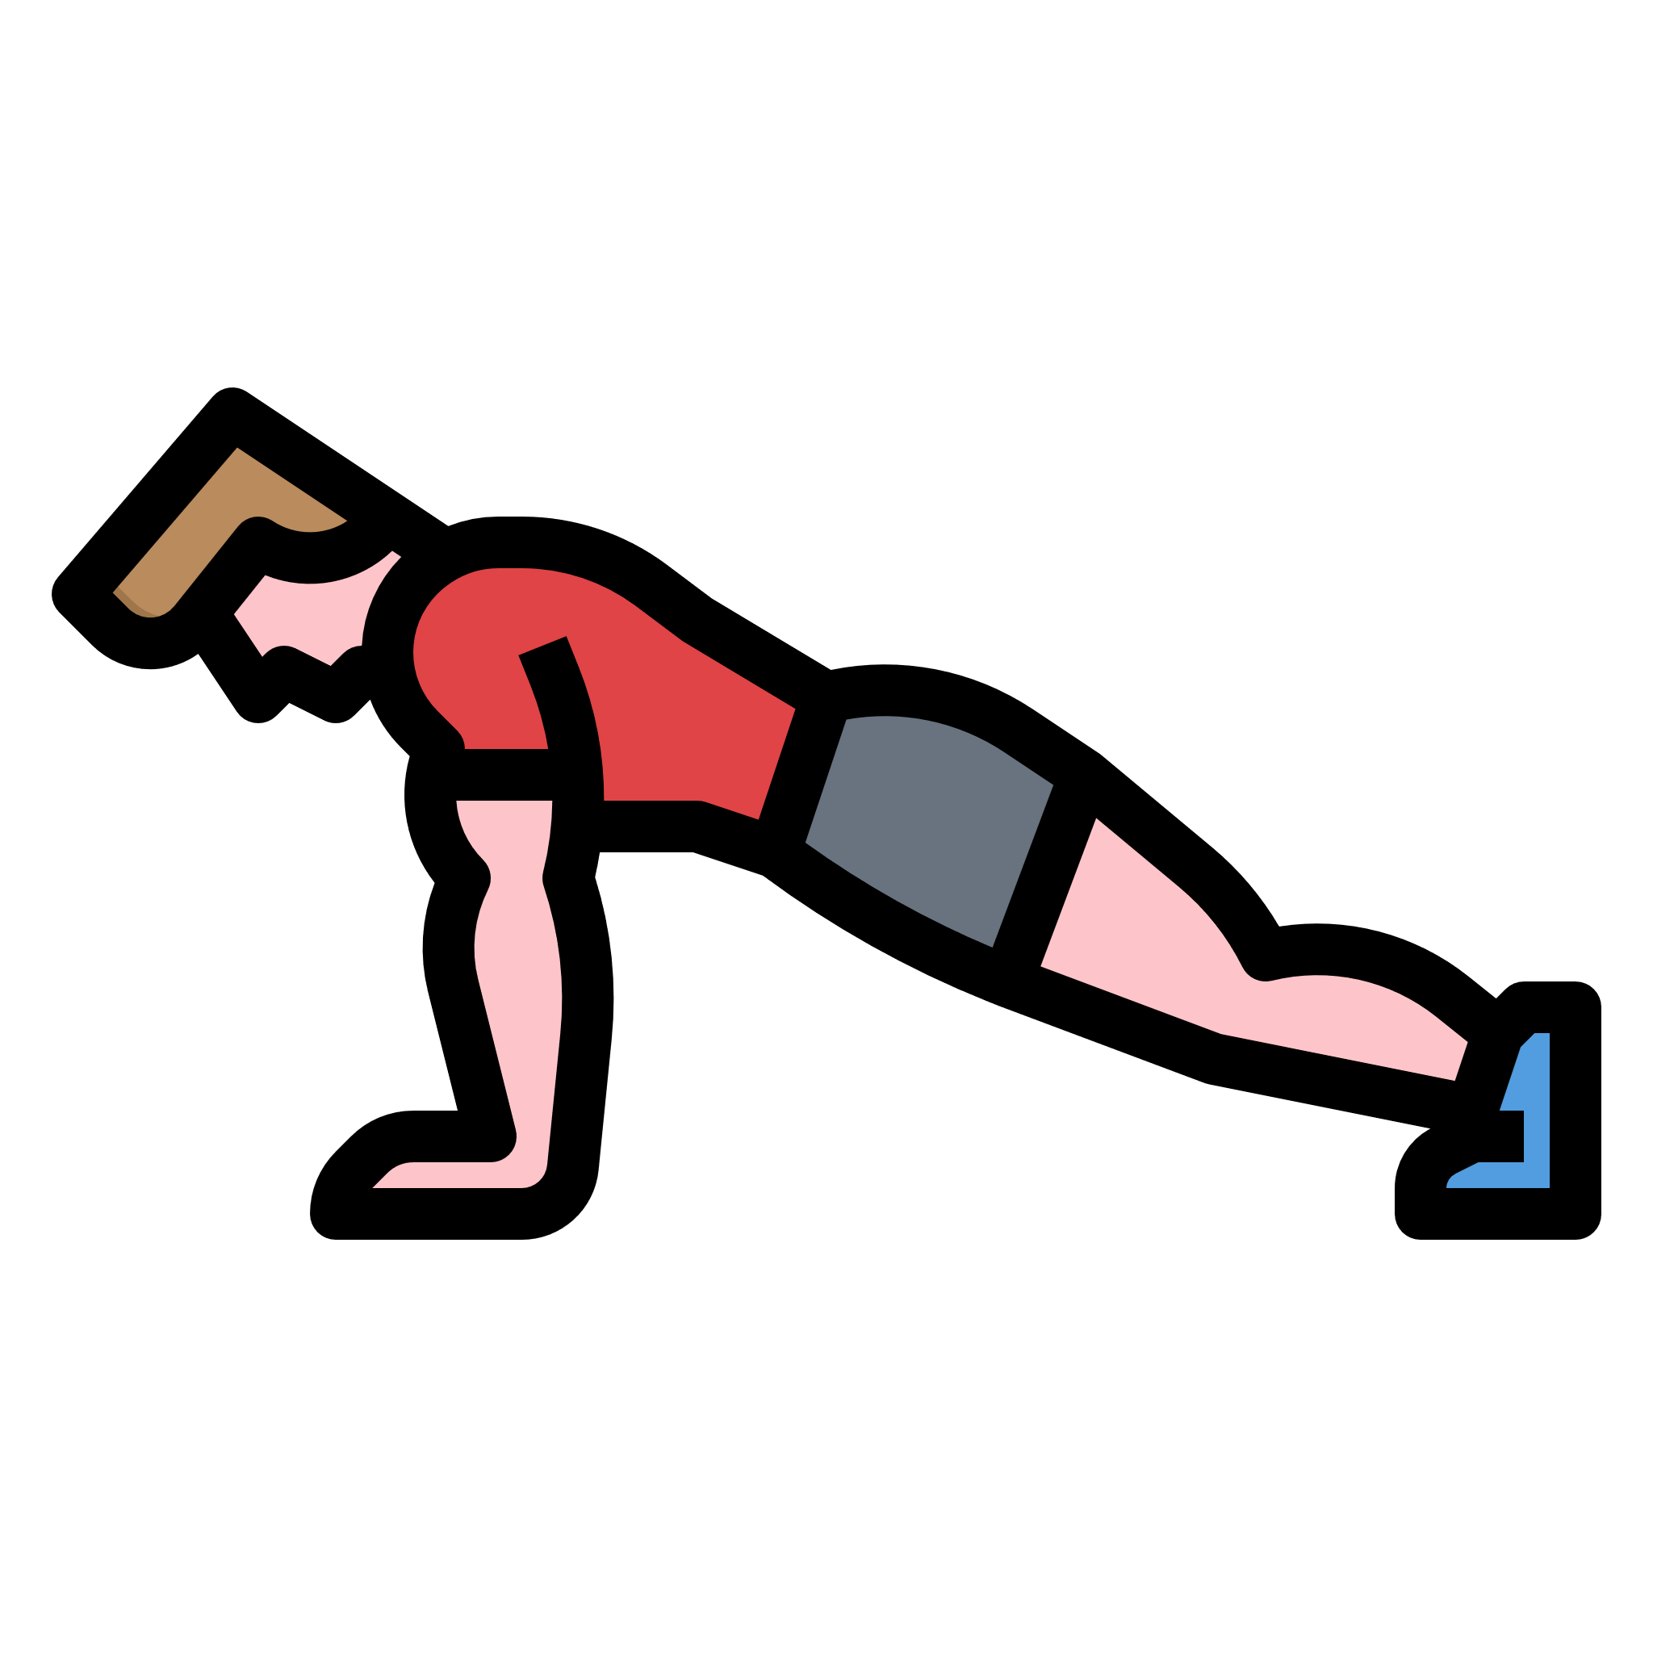
Daily Challenge - PE and Maths #9
Fractions of amounts
Memory tips
To find a fraction of a whole number:
⅖ of 50
Step 1:
Divide the whole number by bottom number (denominator)
50 ÷ 5 = 10
Step 2:
Multiply the answer by the top number (numerator)
10 x 2 = 20
Fraction: Work out | Your Answer | Exercise to complete (Your answer = number of activities)
⅓ of 60 |  | Sit ups
⅖ of 45 |  | Left foot lunges
⅞ of 8 |  | Press ups
⅔ of 27 |  | Right foot lunges
⅙ of 120 |  | Skipping or jumping
⅘ of 40 |  | Bicep curls
⅓ of 72 |  | Jumping jacks
⅜ of 80 |  | Shuttle runs
For more home learning resources, visit www.pescholar.com/home-learning

Slide 9
Daily Challenge - PE and Maths #10
This PE and Maths challenge card has been created to help keep your mind and body active using a quick and fun challenge!
The card is suitable for KS2 to KS3 (ages 8 to 14) to develop or reinforce numeracy skills linked to physical activity with a “using number focus”.
The aim of the challenge is to:
(Physical) Complete a 6 stage work out
(Mathematical) Use your work out to better understand number facts
The rules are:
Complete each physical activity for the time stated
Record your times
Using the instructions solve the sums based on your workout
Extensions: 1. Change the time for each activity 45 seconds becomes 60 seconds etc.
2. Add or change the activities to suit you. Bouncing a ball, catching a ball etc.
For more home learning resources, visit www.pescholar.com/home-learning

Slide 10


Daily Challenge - PE and Maths #10
Playing with numbers
Instructions
Complete Work Out
30 Seconds Press ups
60 Seconds Lunges
45 Seconds Step ups
60 Seconds Star jumps
45 Seconds Sit ups
60 Seconds squats
Compete each activity in the circuit
Record the number of each activity in the box below
Now the Maths
Using the number of activities you have completed
1. Order your activities lowest to highest
2. Order your activities highest to lowest
3. Work out your total score
Add up all your scores
4. Identify any prime numbers
Number with only two factors 1 and itself
5. Identify any square numbers
The same number multiplied together 2 x 2 etc
6. Identify any cubed numbers
The same number multiplied together 3 times
2 x 2 x 2 etc
7. Work out your range
Your highest score minus your lowest score
8. Work out your average number of activities completed (Mean score)
Add up all the numbers then divide by number of activities (6)
For more home learning resources, visit www.pescholar.com/home-learning

