Slide 1

Daily Challenge - PE and Maths #11
This PE and Maths challenge card has been created to help keep minds and bodies active using quick and fun challenges!
The card is suitable for KS2 to KS3 (ages 8 to 14) to develop or reinforce numeracy skills linked to physical activity, with a division focused.
The aim of the challenge is to:
(Physical) Complete sprint shuttle runs to the size of a sports pitch
(Mathematical) Calculate the (by using division) the number of laps required
The rules are:
Create and measure a shuttle run course (measure in metres: 1 big step = approx. 1 metre)
Work out the number of laps you need to run (venue size ÷ size of your course)
Record your answer on the sheet or your own version
Run the laps
Extensions: 1. Change your course to change the sum
2. Investigate and add in your own choice of venues
3. Record how long it takes to run each pitch- Try to better it (Improve speed)
For more home learning resources, visit www.pescholar.com/home-learning

Slide 2
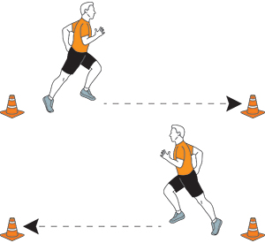
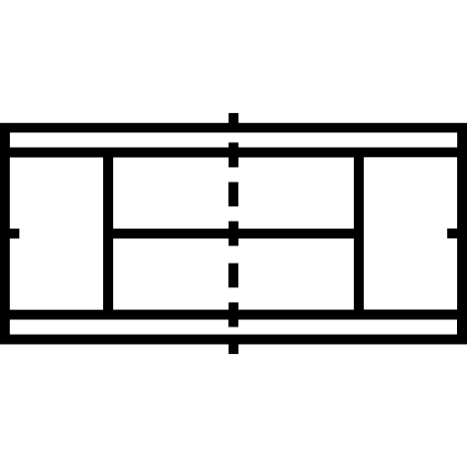
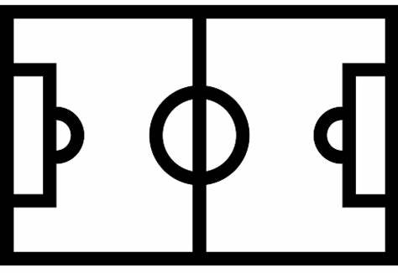
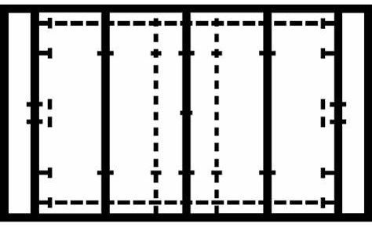

Daily Challenge - PE and Maths #11
Run the Venues ~ 1
Set up your course
Famous Venue | Size of Venue (Approx.) | (÷ by) Your course size | (=) Number of laps to run
Wimbledon Court (Tennis) | 24 Metres
Wembley Pitch (Football) | 80 Metres
Twickenham Pitch (Rugby) | 100 Metres
Lords Pitch (Cricket) | 140 Metres
Measure your course
(Approximately in Metres)
1 big step = 1 metre
Work out the number of laps to run the venue
Venue size ÷ size of course
Run the laps!
For more home learning resources, visit www.pescholar.com/home-learning

Slide 3
Daily Challenge - PE and Maths #12
This PE and Maths challenge card has been created to help keep minds and bodies active using quick and fun challenges!
The card is suitable for KS2 to KS3 (ages 8 to 14) to develop or reinforce numeracy skills linked to physical activity, with a focus on multiples of 12.
The aim of the challenge is to:
(Physical) Complete sprint shuttle runs to the size of famous buildings
(Mathematical) Calculate the (by using multiples of 12) the number of climbs required
The rules are:
Using an average sized stair case (assumed 12 steps)
Work out the number of laps you need to climb (Venue size ÷ 12)
Record your answer on the sheet or your own version
Climb the stairs (Be careful walking/climbing the stairs. Walk down slowly after each climb)
Extensions: 1. Investigate and add in your own choice of venues
2. Record how long it takes to complete each climb
- Try to better it (in a safe way!)
For more home learning resources, visit www.pescholar.com/home-learning

Slide 4






Daily Challenge - PE and Maths #12
Run the Venues ~ 2 Climbing + Endurance
Using your stairs
Famous Venue | Size of Venue (number of floors to the nearest 12) | (÷ by) 12 | (=) number of climbs to complete
Hogwarts | 144
The Shard | 312
Bank of China Tower | 840
One World trade centre | 1248
Burj Khalifa (Challenge) * Largest building in the world | 1956
Focus on dividing by 12
(12 steps per staircase)
Work out the number of times to climb the stairs
Venue size ÷ 12
Complete the climb
For more home learning resources, visit www.pescholar.com/home-learning

Slide 5
Daily Challenge - PE and Maths #13
This PE and Maths challenge card has been created to help keep minds and bodies active using quick and fun challenges!
The card is suitable for KS2 to KS3(ages 8 to 14) to develop or reinforce numeracy skills linked to physical activity, with a focus on knowing the 1st 10 Prime numbers.
The aim of the challenge is to:
(Physical) Complete a multi-stage sit up workout
(Mathematical) To know and be able to order prime numbers
The rules are:
Complete the pyramid (or your own list) from smallest to biggest using the the 1st 10 prime numbers
Complete each stage of the pyramid with that number of Sit ups
Extensions: 1. Remove the prime number help box
2. Swap prime numbers for square number (I.E: 2 x 2 x 2)
3. Change the activity (Press ups or sports skill-keep ups etc)
For more home learning resources, visit www.pescholar.com/home-learning

Slide 6

Daily Challenge - PE and Maths #13
Know your Primes- Sit up challenge
How to do a correct sit up
Lie on the floor facing the ceiling
Slightly bend your knees
Hands should lightly touch your head
Engage your core by lifting your upper body so your elbow touches your opposite knee
Return to the start position
Top Tips
From top to bottom
List the first 10
prime numbers in order
Prime Number = A number with two only two factors: 1 and itself)
Complete the number of sit ups for each stage
__
_________________________
_____________________
__________________
______________
____
_____
______
__________
________
1st 10 Prime Numbers (Help)
5 | 11 | 29 | 3 | 19
29 | 7 | 2 | 13 | 17
For more home learning resources, visit www.pescholar.com/home-learning

Slide 7
Daily Challenge - PE and Maths #14
This PE and Maths challenge card has been created to help keep minds and bodies active using quick and fun challenges!
The card is suitable for KS1 to KS2 (ages 6 to 11) to develop or reinforce numeracy skills linked to physical activity with an improving coordination and “using number focus”.
The aim of the challenge is to:
(Physical) Complete a 6 stage ball skill circuit.
(Mathematical) Use your totals to add up larger numbers and use in different ways.
The rules are:
Complete the ball circuit for 60 seconds each
Record your times on the sheet or on your own version
Using the instructions solve the sums based on your totals
Extensions: 1. Change the time for each activity.
2. Add or change the activities to suit you. Bouncing a ball, catching a ball etc.
    3. Change different ball types to improve coordination.
For more home learning resources, visit www.pescholar.com/home-learning

Slide 8





Daily Challenge - PE and Maths #14
Ball skill coordination and addition
Two hand bouncing
Throw and catch against the wall
Pass the ball between each hand around your waist
1 hand bouncing
Roll and catch the ball against the wall
Throw above your head and catch
Instructions
Compete each activity in the circuit
60 seconds at a time
Use a big ball for each
Record the number of each activity in the box
Maths Work:
1. Add up all you totals
2. Order your totals from biggest to smallest
3. Add your biggest total and smallest total
4. Add your two middle totals
Repeat the circuit with a smaller ball
Complete the Circuit
For more home learning resources, visit www.pescholar.com/home-learning

Slide 9
Daily Challenge - PE and Maths #15
This PE and Maths challenge card has been created to help keep minds and bodies active using quick and fun challenges!
The card is suitable for KS2 to KS3 (ages 8 to 14) to develop or reinforce numeracy skills linked to physical activity, with a focus on interpreting data, specifically pictograms.
The aim of the challenge is to:
(Physical) Complete a varied work out using different activities and a different number of reps.
(Mathematical) Work out the amount of activities by using a pictogram and key.
The rules are:
Use the key (multiples of 5) to complete the total column.
Record your scores, either on the print out or your own version
Complete your work, using the total number and the activities pictured
Extensions: 1. Change the key to change the sum and total number of activities. 2. Add or remove pictures
3. Change the activities to suit you- Football keep ups, catching a ball etc.
For more home learning resources, visit www.pescholar.com/home-learning

Slide 10


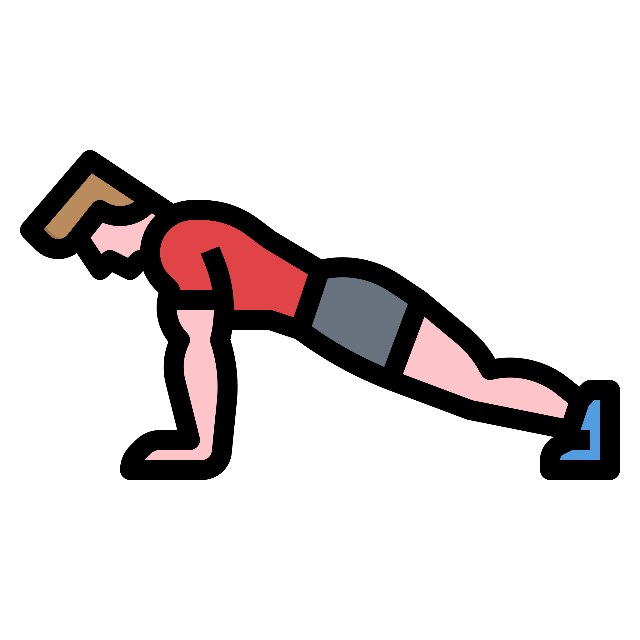


Daily Challenge - PE and Maths #15
Using data - Pictogram
Activity
Sit ups
Lunges (left leg)
Press ups
Lunges (right leg)
Two foot jumps (with or without rope)
Bicep curls (with or without weights)
Star jumps
Shuttle runs
Total
Key:
1 icon = 5 Reps
= 5 Bicep curls
Instructions
Using the key fill in the Total column
(Multiples of 5)
Complete the work out using the totals for each activity
Answer the questions
Most popular activity?
Least popular activity?
Which activities are the same?
For more home learning resources, visit www.pescholar.com/home-learning

