Slide 1

Daily Challenge - PE and Maths #16
This PE and Maths challenge card has been created to help keep your mind and body active using a quick and fun challenge!
The card is suitable for KS2 to KS3 (ages 8 to 14) to develop or reinforce numeracy skills linked to physical activity, using measuring and timing skills with a multiple of 10 focus.
The aim of the challenge is to:
(Physical) Complete different athletic event distances in the best time
(Mathematical) Calculate the (by using division) the number of laps required, time each event and compare.
The rules are:
Create the 5 metre (10m in total) shuttle run course (Measure in metres- 1 big step = 1 metre)
Work out the number of laps you need to run each event (Event distance ÷ size of your course 10m)
Record your answer on the sheet or your own version
Run the laps
Extensions: 1. Add in a small hurdle to change to a hurdle event
2. Change the size of your course to change the math's skill required
3. Investigate and add in your own event distances
For more home learning resources, visit www.pescholar.com/home-learning

Slide 2
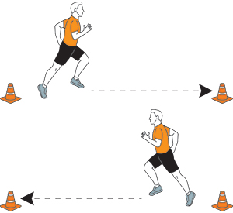

Daily Challenge - PE and Maths #16
Run an Athletic event
Set up your course
Athletics event | Number of laps to run (÷ by course – 10m) | Time taken Attempt 1 | Time taken Attempt 1 | Which attempt was quickest? 1 or 2
100m Sprint
400m Race
800m Race
1500m Race
Endurance Challenge 3000m Race
Set up a 5 metre shuttle run
(10 there and back)
Approx. 1 big step = 1 metre
Work out the number of laps you need to complete
Event distance ÷ course (10)
Run and time your laps
Try to beat your time
For more home learning resources, visit www.pescholar.com/home-learning

Slide 3
Daily Challenge - PE and Maths #17
This PE and Maths challenge card has been created to help keep your mind and body active using a quick and fun challenge!
The card is suitable for KS1 to KS3 (ages 6 to 14) to develop or reinforce numeracy skills linked to physical activity and clock familiarisation. (hours and minutes)
The aim of the challenge is to:
(Physical) Complete a 1 hour challenge, progressively getting harder on a chosen activity
(Mathematical) Using and understanding clock terminology. Learning to tell the time.
The rules are:
Choose an activity for your work out
Using an analogue clock start the challenge on the hour (any hour will work)
As the minute hand reaches each number, complete each activity for that time
For basic work out use hour numbers- At 1 complete 1 activity
For more advanced work out use minute numbers – At 1 complete 5 for 5 past.
Extensions: 1. Change the activates
2. Complete for 30 minutes using advanced work out
For more home learning resources, visit www.pescholar.com/home-learning

Slide 4

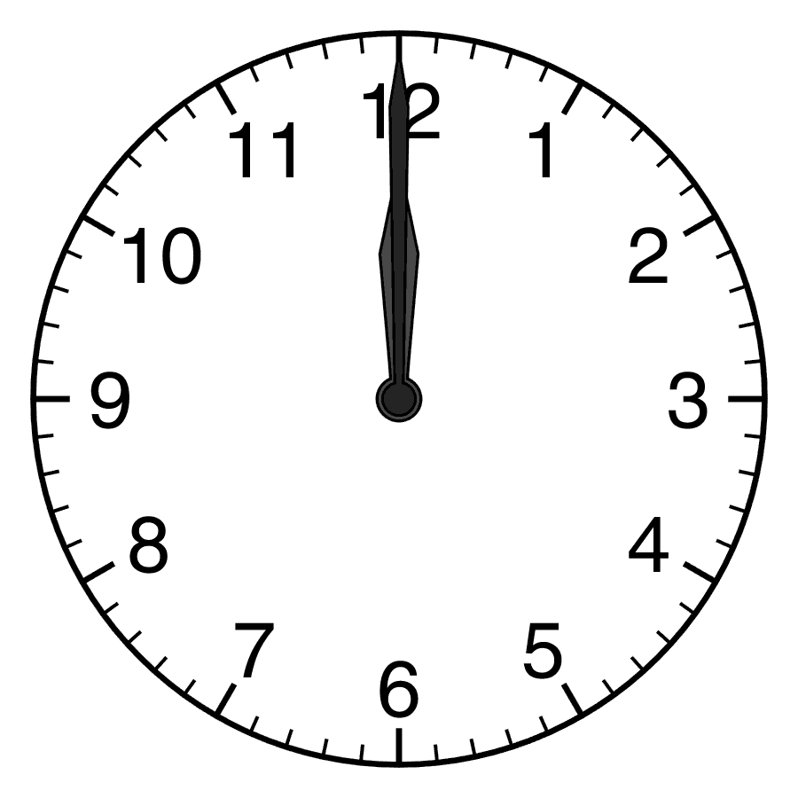



Daily Challenge - PE and Maths #17
On time 1 hour challenge
Choose your activity
Press ups
Sits ups
Running laps
Skipping
Instructions
Choose your activity
Start on the hour (any hour is suitable)
When the minute hand gets to the next number complete the activity for that time. Rest in-between.
Basic challenge = 1 at 5 past, 2 and 10 past etc.
Advanced challenge = 5 at 5 past, 10 at 10 past etc.
Further maths= Work out the total number activities.
Add up all you have completed
For more home learning resources, visit www.pescholar.com/home-learning

Slide 5
Daily Challenge - PE and Maths #18
This PE and Maths challenge card has been created to help keep your mind and body active using a quick and fun challenge!
The card is suitable for KS1 to KS3 (ages 6 to 14) to develop or reinforce numeracy skills linked to physical activity, with a focus on interpreting data, specifically bar charts.
The aim of the challenge is to:
(Physical) Complete a varied work out using different activities and a different number of reps.
(Mathematical) Work out the amount of activities by using a bar chart. Answering questions linked to it.
The rules are:
Using the bar chart work out the number of each activity
Complete your work out, using the total number of each bar
Answer the questions linked to the bar chart
Extensions: 1. Create and make up your own bar chart using different numbers and activities 2. Change the activities to suit you- Football keep ups, catching a ball etc.
For more home learning resources, visit www.pescholar.com/home-learning

Slide 6



Daily Challenge - PE and Maths #18
Using data- Bar Charts
Using the bar chart work out the number of each activity completed
Complete the work out using the bar chart for each activity
Answer the questions
Most popular activity?
Least popular activity?
Which activities are the same?
Mean number completed?
(add all activities and divide by 6)
Range number?
(biggest number minus the smallest number)
Instructions
For more home learning resources, visit www.pescholar.com/home-learning

Slide 7
Daily Challenge - PE and Maths #19
This PE and Maths challenge card has been created to help keep your mind and body active using a quick and fun challenge!
The card is suitable for KS1 to KS2 (ages 2 to 11) to develop or reinforce numeracy skills linked to physical activity, with a focus on making number bonds to 50.
The aim of the challenge is to:
(Physical) Complete a 10 activity work out
(Mathematical) To add and match numbers to make 50
The rules are:
Complete the work out in any order, using the activities and their number of reps or seconds
Once complete, match up the pairs of activities that add up to make 50
Extensions: 1. Make up your own workout pairs of activities to make 50 (I.E 40 +10)
2. Change the top number (From 50 to a different number) (60 etc.) and make up your own number pairs
3. Use number pairs that make 50 but with a different operation (x, -, ÷)
For more home learning resources, visit www.pescholar.com/home-learning

Slide 8

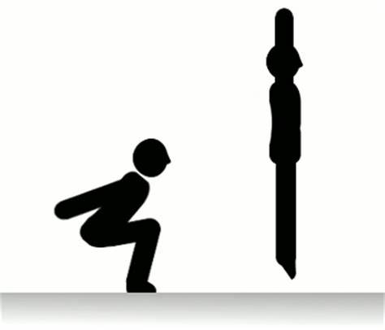


Daily Challenge - PE and Maths #19
Number bonds to 50
Sit ups
22
Squats
33
Instructions
Complete the 10 stage work out in any order using the number for reps or seconds
Match the exercise numbers so that each pair adds up to make 50
Repeat the work out reversing the numbers for each pair
Plank
17 Seconds
Running on a spot
35 Seconds
Lunges
(alternate leg)
36
Star jumps
28
High jumps
7
Bicep Curls
43
Press ups
14
V Sit
15 Seconds
For more home learning resources, visit www.pescholar.com/home-learning

Slide 9
Daily Challenge - PE and Maths #20
This PE and Maths challenge card has been created to help keep your mind and body active using a quick and fun challenge!
The card is suitable for KS1 to KS3 (ages 6 to 14) to develop or reinforce numeracy skills linked to physical activity with an improving coordination, multiplication and addition.
The aim of the challenge is to:
(Physical) Complete a 5 stage ball coordination set of activities for 60 seconds each
(Mathematical) Use your scores with multiplication to work out new scores and totals.
The rules are:
Complete each ball activity for 60 seconds each
Record your score on the sheet or on your own version
Using the multiplication factors, complete each column- add up the totals at the bottom.
Extensions: 1. Change the time for each activity.
      2. Change the multiplication factors for harder sums
3. Add or change the activities to suit you.
    4. Change different ball types to improve coordination.
For more home learning resources, visit www.pescholar.com/home-learning

Slide 10





Daily Challenge - PE and Maths #20
60 seconds - Ball skill challenge – Multiplication
Instructions
Ball Skill | Number completed in 60 seconds | Answer: multiplied by 2 | Answer: multiplied by 10 | Answer: multiplied by its self
Football keep ups
1 handed catching (small ball)
Throwing and catching ball against a wall (any ball)
One handed bouncing (any ball)
Paired throwing and catching a small ball
Total:
Compete each activity
60 seconds at a time
Record the number of each activity in the 1st Column
Maths Work:
Using your score, complete each column by using the multiplication sum
(x2 ~ x10 ~ x by own score)
2. Add up all totals at the bottom of each column
Repeat the skills with a different balls
Change multiplier to practise different math skills.
For more home learning resources, visit www.pescholar.com/home-learning

