Slide 1

Daily Challenge - PE and Maths #21
This PE and Maths challenge card has been created to help keep your mind and body active using a quick and fun challenge!
The card is suitable for KS2 to KS3 (ages 8 to 14) to develop or reinforce numeracy skills linked to physical activity and problem solving.
The aim of the challenge is to:
(Physical) Complete a 1 hour challenge, progressively getting harder on a chosen activity
(Mathematical) Using and understanding clock terminology. Learning to tell the time.
The rules are:
Choose level 1 or level 2
Using the picture information work out what each picture represents
Complete the table below the problem or on your own grid
Complete the work out, each row at a time using your solved answers for each activity.
Extensions: 1. Go to the next level
      2. Change the activities
      3. Make up your own picture problems
For more home learning resources, visit www.pescholar.com/home-learning

Slide 2



Daily Challenge - PE and Maths #21
Problem solving workout
Level 1
 | = 6
 | = 10
 | = 12
 | =
Level 2
 | = 15
 | = 19
 | = 22
 | =
 | =
Instructions
Pick your level
Using the information you are given work out what the number each picture represents
(fill in your answers at the bottom)
Complete the work out each row at a time
Press ups: | =
Sit ups: | =
Star Jumps | =
Press ups: | =
Sit ups: | =
Star Jumps | =
For more home learning resources, visit www.pescholar.com/home-learning

Slide 3
Daily Challenge - PE and Maths #22
This PE and Maths challenge card has been created to help keep your mind and body active using a quick and fun challenge!
The card is suitable for KS1 to KS3 (ages 6 to 12) to develop or reinforce numeracy skills linked to physical activity, developing number patterns and learning times tables.
The aim of the challenge is to:
(Physical) Complete a progressive work out on a chosen activity
(Mathematical) Calculate the multiples of a chosen number (learn the times tables)
The rules are:
Choose a number, color in on the grid (or your own) the multiples of that number (the times table)
Choose a work out activity (Shuttle runs, star jumps, high jumps or sit ups)
Complete the work out of all the colored squares, resting in between each number.
Extensions: 1. Choose different multiplies (x7, x12 etc.)
2. Change the activity to complete
3. Add in your own activities
4. Mix and match activities for odd and even numbers
For more home learning resources, visit www.pescholar.com/home-learning

Slide 4
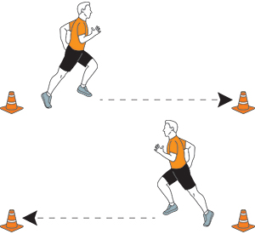
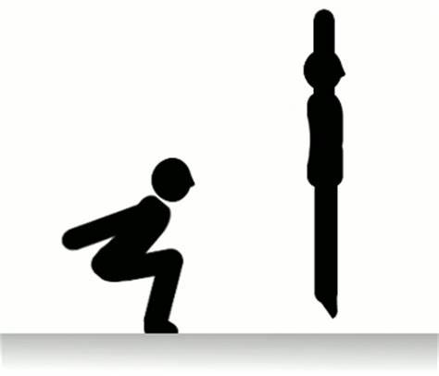
Daily Challenge - PE and Maths #22
Times table endurance work out ~ 4 in 1
1 | 2 | 3 | 4 | 5 | 6 | 7 | 8 | 9 | 10
11 | 12 | 13 | 14 | 15 | 16 | 17 | 18 | 19 | 20
21 | 22 | 23 | 24 | 25 | 26 | 27 | 28 | 29 | 30
31 | 32 | 33 | 34 | 35 | 36 | 37 | 38 | 39 | 40
41 | 42 | 43 | 44 | 45 | 46 | 47 | 48 | 49 | 50
51 | 52 | 53 | 54 | 55 | 56 | 57 | 58 | 59 | 60
61 | 62 | 63 | 64 | 65 | 66 | 67 | 68 | 69 | 70
71 | 72 | 73 | 74 | 75 | 76 | 77 | 78 | 79 | 80
81 | 82 | 83 | 84 | 85 | 86 | 87 | 88 | 89 | 90
91 | 92 | 93 | 94 | 95 | 96 | 97 | 98 | 99 | 100
Instructions
Choose your times table
(Example: times by 4 etc)
Colour in all the multiples
(Example: in the 4 times table)
Choose your activity
(Example: high jumps)
Complete work out
(Example: 4, 8, 12 jumps)
Rest between each number.
Change number and or activity and repeat
X6
Multiples of 6
X7
Multiples of 7
X4
Multiples of 4
X3
Multiples of 3
For more home learning resources, visit www.pescholar.com/home-learning

Slide 5
Daily Challenge - PE and Maths #23
This PE and Maths challenge card has been created to help keep your mind and body active using a quick and fun challenge!
The card is suitable for KS2 to KS3 (ages 8 to 14) to develop or reinforce numeracy skills linked to physical activity, using coordinates to guide the work out.
The aim of the challenge is to:
(Physical) Complete a varied work out using different activities
(Mathematical) Work out positive and negative coordinates to correctly order the work out
The rules are:
Using the coordinates given locate and identify each work out activity in order
Complete your work out in order, each picture represents 20 reps or a 30 second hold
Extensions: 1. Create and make up your own work out map
2. Change the activities to suit you – e.g. football keep ups, catching a ball etc.
      3. Change the length of time or number of reps for each activity
For more home learning resources, visit www.pescholar.com/home-learning

Slide 6
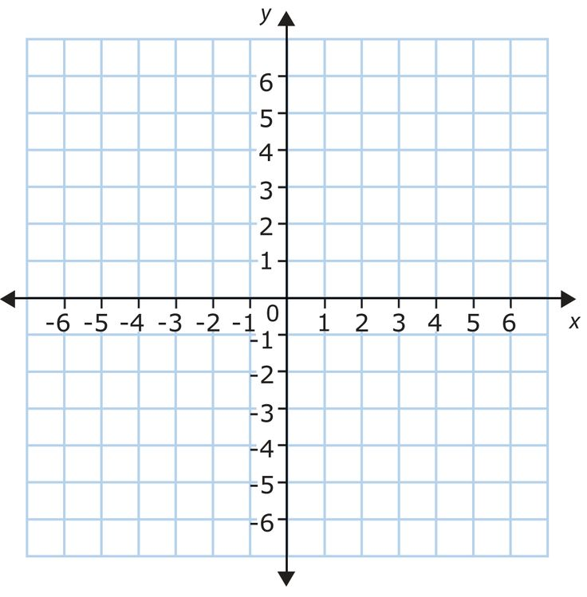







Daily Challenge - PE and Maths #23
Coordinates
Instructions
Using the coordinators below
Complete the work out in the correct order
Each activity is 20 reps or hold for 30 seconds
Remember:
(2, 4)
1st Number X axis- left or right 2nd Number Y axis - Up or down
1. | (2,2)
2. | (1, -2)
3. | (-4, 6)
4. | (-2, -2)
5. | (-6, 2)
6. | (3, 6)
7. | (6, -5)
8. | (-2, 1)
9. | (4, 4)
10. | (-5, -4)
For more home learning resources, visit www.pescholar.com/home-learning

Slide 7
Daily Challenge - PE and Maths #24
This PE and Maths challenge card has been created to help keep your mind and body active using a quick and fun challenge!
The card is suitable for KS1 to KS3 (ages 6 to 14) to develop or reinforce numeracy skills linked to physical activity, with a focus on 2D shapes and multiplication.
The aim of the challenge is to:
(Physical) Complete a multi-lap running course
(Mathematical) To know the basic proprieties of 2D shapes and practice basic multiplication
The rules are:
Set up your own running course (choose distance and route)
Complete the 2D shape table or your own version. Solve the last column by multiplying the number of sides by the number of corners (vertices)
Use this final number for the number of laps to run around your course.
Extensions: 1. Make your route bigger or smaller
2. Add in a skill when running your route (bouncing or dribbling a ball)
3. Work out the total distance ran (eg. measure your course, multiple it by total number of laps)
For more home learning resources, visit www.pescholar.com/home-learning

Slide 8
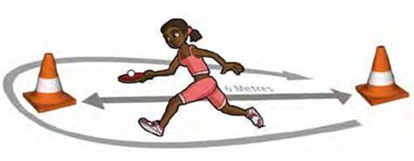






Daily Challenge - PE and Maths #24
2D Shapes
Set up a running course
(you choose distance and route)
Complete the 2D shape table
Work out the last column by multiplying the number of sides by the number of corners (vertices).
Use this final to indicate the number of laps to run of your course.
Extras:
Work out your total distance by measuring your course and multiplying by your total number of laps
Dd in a skill like a bouncing a ball as you run your laps.
Instructions
2D Shape | Name of shape | Number of sides | Number of corners (vertices) | Number of laps to run Answer: multiply (sides x vertices)
For more home learning resources, visit www.pescholar.com/home-learning

Slide 9
Daily Challenge - PE and Maths #25
This PE and Maths challenge card has been created to help keep your mind and body active using a quick and fun challenge!
The card is suitable for KS1 to KS3 (ages 6 to 14) to develop or reinforce numeracy skills linked to physical activity, with a focus on 3D shapes and multiplication.
The aim of the challenge is to:
(Physical) Complete a multi-lap running course
(Mathematical) To know the basic proprieties of 3D shapes and practice basic multiplication
The rules are:
Set up your own running course (choose distance and route)
Complete the 3D shape table or your own version. Solve the last column by multiplying the number of faces by the number of corners (vertices) by the number of edges.
Use this final number for the number of laps to run around your course.
Extensions: 1. Make your route bigger or smaller
2. Add in a skill when running your route (bouncing or dribbling a ball)
3. Work out the total distance ran (eg. measure your course, multiple it by total number of laps)
For more home learning resources, visit www.pescholar.com/home-learning

Slide 10
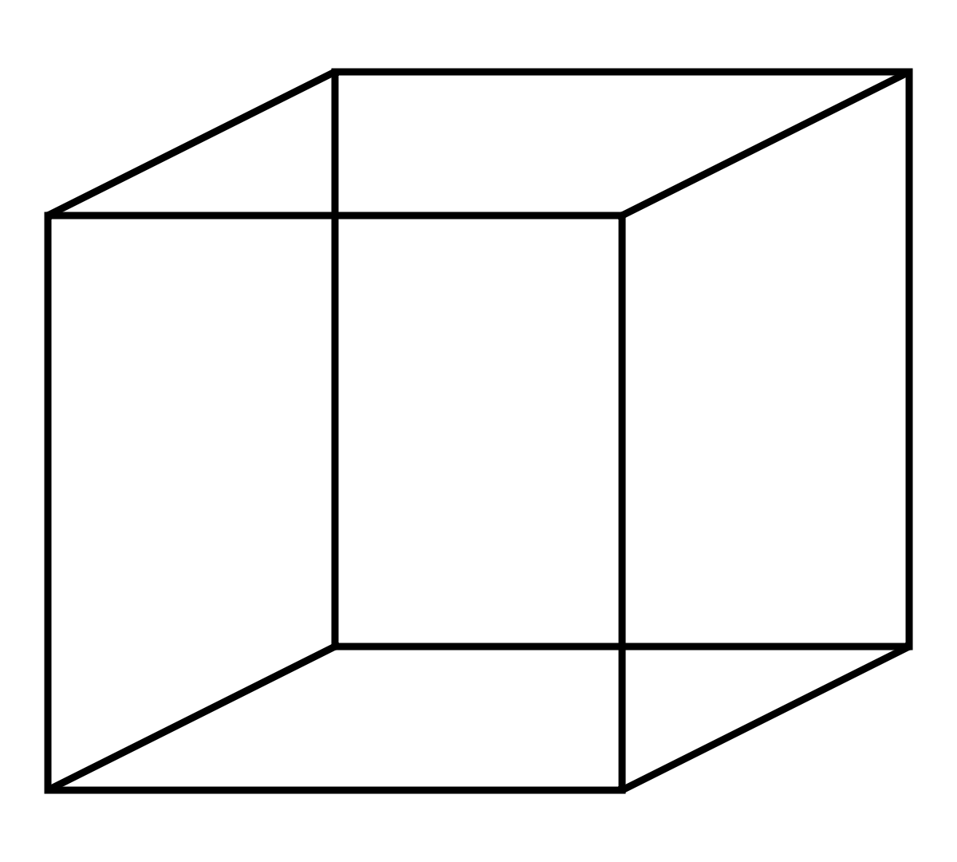
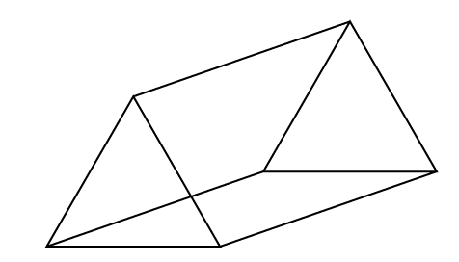
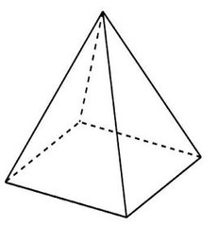
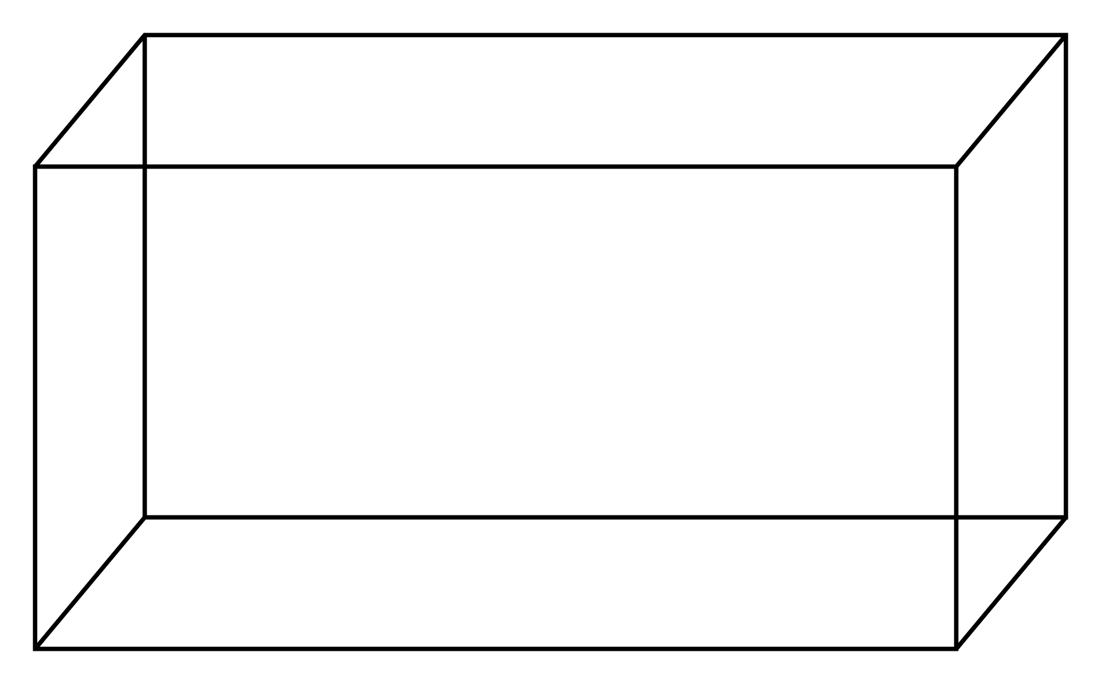
Daily Challenge - PE and Maths #25
3D Shapes
Set up a running course
(you choose distance and route)
Complete the 3D shape table
Work out the last column by multiplying the number of face by the number of corners (vertices) by the number of edges
Use this final to indicate the number of laps to run of your course.
Extras:
Work out your total distance by measuring your course and multiplying by your total number of laps
Dd in a skill like a bouncing a ball as you run your laps.
Instructions
3D Shape | Name of shape | Number of faces | Number of corners (vertices) | Number of edges | Number of laps to run Answer: multiply (Faces x vertices x edges)
For more home learning resources, visit www.pescholar.com/home-learning

