Slide 1
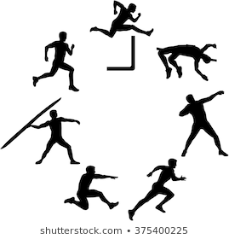
My Sports Day Week
Personal Best Sports Day Events
A set of 5 sport event resource cards and a sports week results and recording table. Designed for a home learning Sports Day, for each day of the week, to try to achieve your personal best in each event.
This resource has been designed to be used in two ways.
  Complete all 5 activities every day across the week. Record your scores everyday and identified your personal best for each event.
Or
Focus on 1 event each day. Spend time practising the event and then record your personal best for that day.
Included with the resource:
1. Two record and results tables,
One for all events every day
One for 1 event each day.
2. 5 Event cards, one for each activity
Long jump
Ball throw
Endurance running
Triple jump
Sprint race

Slide 2
My Sports Day Week
Records and Results – All Events
Event | Day 1 | Day 2 | Day 3 | Day 4 | Day 5
Long Jump (Distance in steps)
Ball Throw (Distance in steps)
Endurance running (Time in minutes)
Triple jump (Distance in steps)
Sprint (Time in seconds)

Slide 3
My Sports Day Week
Records and Results – 1 Event per Day
Event | _________
Attempt 1
Attempt 2
Attempt 3
Attempt 4
Attempt 5
Event | _________
Attempt 1
Attempt 2
Attempt 3
Attempt 4
Attempt 5
Event | _________
Attempt 1
Attempt 2
Attempt 3
Attempt 4
Attempt 5
Event | _________
Attempt 1
Attempt 2
Attempt 3
Attempt 4
Attempt 5
Event | _________
Attempt 1
Attempt 2
Attempt 3
Attempt 4
Attempt 5
My Personal Best
1
2
3
4
5

Slide 4
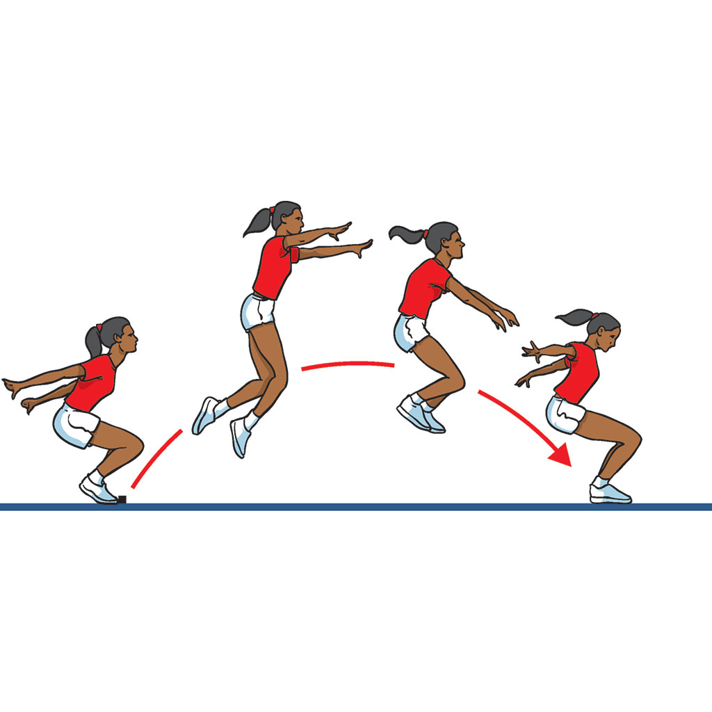
My Sports Day Week
Event 1 - Long Jump
Instructions:
Choose a starting point (take off)
Either run and jump or from standing position and jump
Measure your distance from your back foot. (In steps)
Top tips - Long Jump Technique
Consistent run up speed
Use a flat foot take off, on your strongest leg
In the air thrust your free leg in front of your body as long as possible. Bring your arms forward, as if you are trying to reach for your toes.
When landing try to fall forwards or side ways!

Slide 5
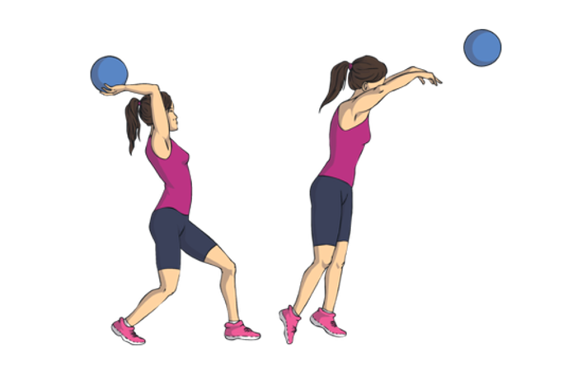
My Sports Day Week
Event 2 - Large Ball Throw
Instructions:
In an open space, decide a throw line
From standing position throw the ball (overhead) as far as you can
Measure your distance in steps
Top tips - Overhead Technique
Use both hands, one on each side of the ball
Arch your back slightly, Bring the ball up and over your head.
Release the ball with a forward flick of the wrists

Slide 6

My Sports Day Week
Event 3 - Endurance Running
Instructions:
Decide and agree a suitable run course (playing field, back garden etc)
Agree number of laps
Run race, record time on stop watch
Top tips - Long Distance Running
When running
Keep knees slightly bent
Chest for wad, shoulder relaxed
Head up, eyes focused ahead
Arms swing close to body
Middle of foot landing on the ground

Slide 7
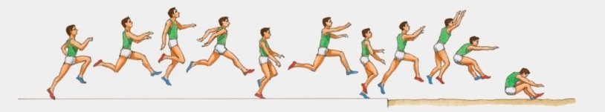
My Sports Day Week
Event 4 - Triple Jump
Instructions:
Choose a starting point (take off)
Either run up or from standing position complete a hop, step and jump in one action
Measure your distance from your back foot. (In steps)
Top tips - Triple Jump
Hop phase- take off and land on same foot (strongest foot)
Step phase- land on the other foot to which was used to take off
Jump phase – use long jump technique, land sideways or forward

Slide 8
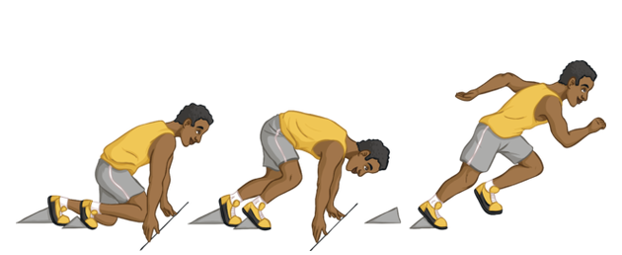
My Sports Day Week
Event 5 - Sprint Race
Instructions:
Decide and agree a suitable short running course with a start and end point (post to post etc)
With a on your marks, get set, go sprint the race
Record time on stop watch
Top tips - Sprint Running
When sprinting
Head up, eyes looking ahead
Arms swing forwards and backwards
Stride length long, hips facing forward
High knees
Run on balls of feet

