Slide 1
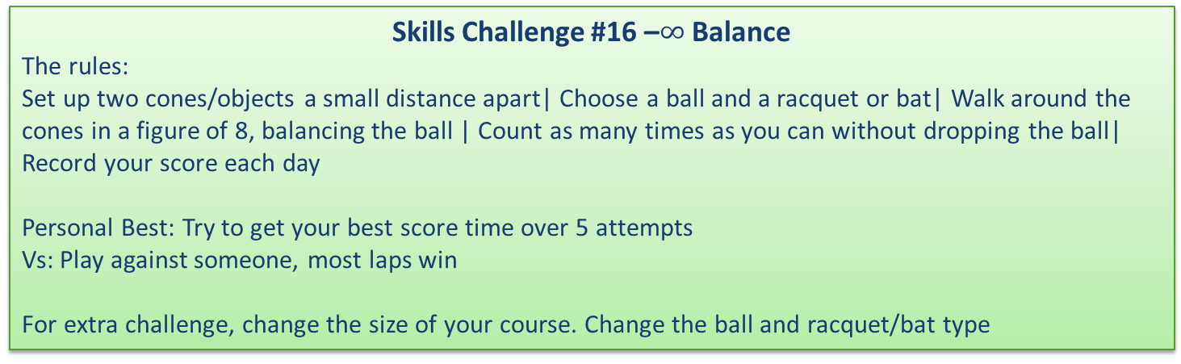

Skills Challenge #16
$$∞Balance$$
A set of challenges designed to improve a variety of fundamental sports skills. Created for individual use with a personal best challenge or with a friend or family member in a head to head. These skills challenges are aimed at 6-14 year olds but are fun for any age!
The purpose of each challenge is to improve skills in a fun, enjoyable way.
Each challenge has a skill component focus
Skills Challenge #16 Focus: Balance and Agility
Skills Challenge #16 –$∞$ Balance
The rules:
Set up two cones/objects a small distance apart| Choose a ball and a racquet or bat| Walk around the cones in a figure of 8, balancing the ball | Count as many times as you can without dropping the ball| Record your score each day
Personal Best: Try to get your best score time over 5 attempts
Vs: Play against someone, most laps win
For extra challenge, change the size of your course. Change the ball and racquet/bat type
For more home learning resources, please visit: pescholar.com/home-learning

Slide 2
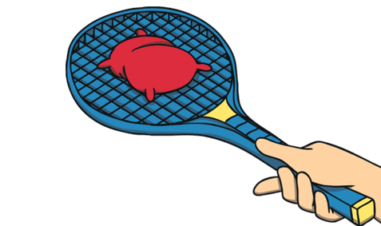

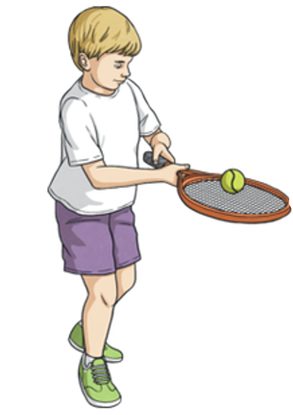

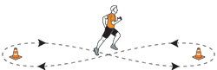
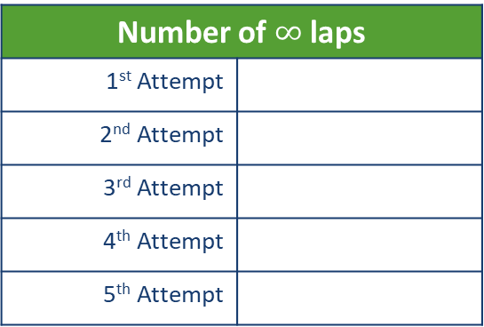
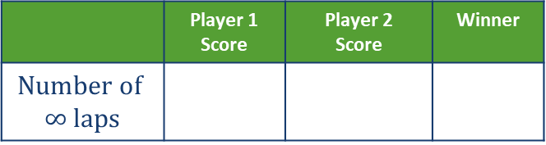
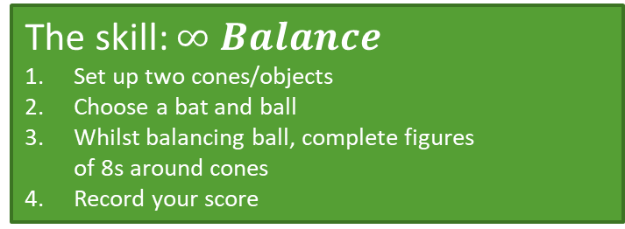
Skills Challenge #16
The skill: $∞ Balance$
Set up two cones/objects
Choose a bat and ball
Whilst balancing ball, complete figures of 8s around cones
Record your score
Focus on: Balance
and agility
5 Attempts | Record your laps |
What is your best day?
Number of $∞$ laps
1st Attempt
2nd Attempt
3rd Attempt
4th Attempt
5th Attempt
Vs Challenge
Personal Best: Challenge
Head to head | Record your scores| Who wins?
 | Player 1 Score | Player 2 Score | Winner
$$Number of$$ $$∞ laps$$
For more home learning resources, please visit: pescholar.com/home-learning

Slide 3
Skills Challenge #17
Crunch time
A set of challenges designed to improve a variety of fundamental sports skills. Created for individual use with a personal best challenge or with a friend or family member in a head to head. These skills challenges are aimed at 6-14 year olds but are fun for any age!
The purpose of each challenge is to improve skills in a fun, enjoyable way.
Each challenge has a skill component focus
Skills Challenge #17 Focus: Strength
Skills Challenge #17 – Crunch time
The rules:
From starting potion| Complete as many correct sit up as you can in 90 seconds| Record your score
Personal Best: Try to get your best score over 5 days
Vs : Play against someone, best score wins, best of three
Hold weights to increase challenge
Reduce the time to make the challenge easier
For more home learning resources, please visit: pescholar.com/home-learning

Slide 4
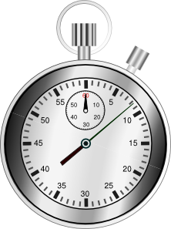
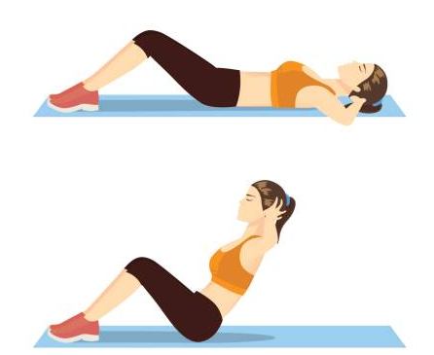
Skills Challenge #17
The skill: Crunch time
1. From sit up position
2. Complete as many Sit ups as you can
3. In 90 seconds
4. Record your score
Focus on:
Strength
Personal Best: Challenge
5 Days | 90 Seconds|
Record your scores |
What is your personal best?
Number of Sit Ups
Day 1
Day 2
Day 3
Day 4
Day 5
Head to head | Best of three| Record your scores
Who wins?
 | Player 1 Score: | Player 2 Score: | Winner
1st 90 Seconds
2nd 90 Seconds
3rd 90 Seconds
Vs Challenge
For more home learning resources, please visit: pescholar.com/home-learning

Slide 5
Skills Challenge #18
Target Strike
A set of challenges designed to improve a variety of fundamental sports skills. Created for individual use with a personal best challenge or with a friend or family member in a head to head. These skills challenges are aimed at 6-14 year olds but are fun for any age!
The purpose of each challenge is to improve skills in a fun, enjoyable way.
Each challenge has a skill component focus.
Skills Challenge #18 Focus: Hand eye coordination – Accuracy
Skills Challenge #18 – Target strike
The rules:
Set up a target (cone, stump, post)| Agree a distance away from the target | Using a ball (Tennis balls or bean bags) | Throw ball to hit target | Record your score out of 5 attempts.
Personal Best: Try to get your best score out of 5 attempts
Vs: Play against someone, best score, best of three wins
For extra challenge | Change the distance from target | Reduce target size|
For more home learning resources, please visit: pescholar.com/home-learning

Slide 6


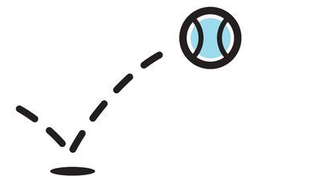
Skills Challenge #18
The skill: Target Strike
Set up a target (cone or stump)
Decide a distance away from the target
5 attempts to hit target
Record your score
Focus on:
Hand Eye
Coordination – Accuracy
Personal Best: Challenge
Vs Challenge
5 Attempts | Record your scores
What is your personal best?
Head to head | 3 attempts each | Record your scores
Who wins?
 | Player 1 Score /5 | Player 2 Score /5 | Winner
1st Attempt
2nd Attempt
3rd Attempt
 | Score out of 5
1st Attempt
2nd Attempt
3rd Attempt
4th Attempt
5th Attempt
For more home learning resources, please visit: pescholar.com/home-learning

Slide 7
Skills Challenge #19
Shuttle Speed
A set of challenges designed to improve a variety of fundamental sports skills. Created for individual use with a personal best challenge or with a friend or family member in a head to head. These skills challenges are aimed at 6-14 year olds but are fun for any age!
The purpose of each challenge is to improve skills in a fun, enjoyable way.
Each challenge has a skill component focus.
Skills Challenge #19 Focus: Speed and agility
Skills Challenge #19 – Shuttle Speed
The rules:
Set up 5 markers different distances apart| Sprint to each marker and back to start in turn | Time yourself| Record your time
Personal Best: Try to get your quickest time in 3 attempts
Vs: Play against someone, best of three wins
Use cones or household objects to make your course
Change the distance of markers to add extra challenge | Add hurdles to improve agility
For more home learning resources, please visit: pescholar.com/home-learning

Slide 8

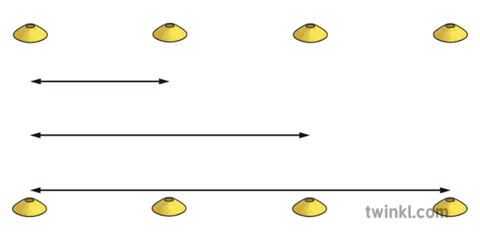

Skills Challenge #19
The skill: Shuttle speed
Set out a 5 marker course
Sprint to each marker and back
Time yourself
Record your times
Focus on: Speed
and Agility
Personal Best: Challenge
3 Attempts| Record your scores
What is your personal best?
Shuttle Speed | Time
Attempt 1:
Attempt 2:
Attempt 3:
Head to head| Record your scores
Who wins?
Shuttle Speed | Time | Time | Winner
Player 1:
Player 2:
Vs Challenge
For more home learning resources, please visit: pescholar.com/home-learning

Slide 9
Skills Challenge #20
V Sit
A set of challenges designed to improve a variety of fundamental sports skills. Created for individual use with a personal best challenge or with a friend or family member in a head to head. These skills challenges are aimed at 6-14 year olds but are fun for any age!
The purpose of each challenge is to improve skills in a fun, enjoyable way.
Each challenge has a skill component focus
Skills Challenge #20 Focus: Strength
Skills Challenge #20 –V Sit
The rules:
From V sit position| Hold the correct position as long as possible| Record your time each day | Do you improve?
Personal Best: Try to get your longest time over 5 days
Vs: Play against someone, longest time wins
For extra challenge, research and try other sitting postions.
For more home learning resources, please visit: pescholar.com/home-learning

Slide 10
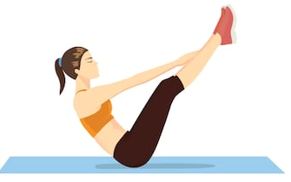
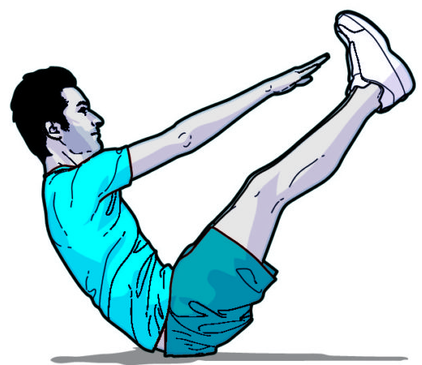
Skills Challenge #20
The skill: V sit
From V sit position
Hold the correct position for as long as possible
Record your time daily, Do you improve?
Focus on: Strength
Daily Attempt | Record your times |
What is your best day?
V Sit Daily (time in seconds)
Monday
Tuesday
Wednesday
Thursday
Friday
Personal Best: Challenge
Head to head | Record your scores| Who wins?
 | Player 1 Time | Player 2 Time | Winner
V Sit
Vs Challenge
For more home learning resources, please visit: pescholar.com/home-learning

