Slide 1
Skills Challenge #21
Climb the Gherkin
A set of challenges designed to improve a variety of fundamental sports skills. Created for individual use with a personal best challenge or with a friend or family member in a head to head. These skills challenges are aimed at 6-14 year olds but are fun for any age!
The purpose of each challenge is to improve skills in a fun, enjoyable way.
Each challenge has a skill component focus
Skills Challenge #21 Focus: Endurance
Skills Challenge #21 – Climb the Gherkin
The rules:
Over 5 days climb the 1037 steps to the top of the Gherkin| Using the climber exercise | Climb 208 steps per day | Record your daily time and add for total time
Personal Best: Time your 208 steps each day, try to get quicker each day
Vs : Play against someone, quickest time to the top wins
To increase the challenge complete the total steps in fewer days
For more home learning resources, please visit: pescholar.com/home-learning

Slide 2


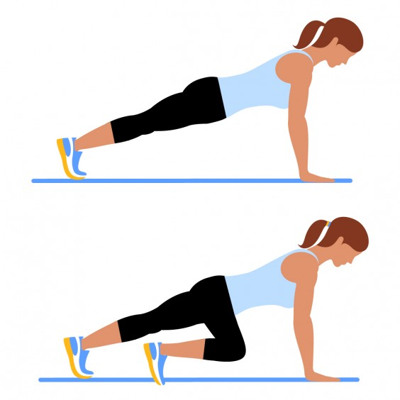
Skills Challenge #21
The skill: Climb the Gherkin
1. Climb 1037 steps in 5 days
2. Using the mountain climber exercise
3. Complete 208 steps each day
4. Time each day and add together for total time
Focus on:
Endurance
Personal Best: Challenge
5 Days | 208 Steps|
Record your times| Add your times |
What is your personal best day?
Climb time
Day 1 (208 steps) time
Day 2 (208 steps) time
Day 3 (208 steps) time
Day 4 (208 steps) time
Day 5 (208 steps) time
Total time
Head to head | Race to the top | Best time wins
 | Player 1 Score: | Player 2 Score: | Winner
Total climb time
Vs Challenge
For more home learning resources, please visit: pescholar.com/home-learning

Slide 3
Skills Challenge #22
In The Bucket
A set of challenges designed to improve a variety of fundamental sports skills. Created for individual use with a personal best challenge or with a friend or family member in a head to head. These skills challenges are aimed at 6-14 year olds but are fun for any age!
The purpose of each challenge is to improve skills in a fun, enjoyable way.
Each challenge has a skill component focus.
Skills Challenge #22 Focus: Hand eye coordination – Accuracy
Skills Challenge #22 – In the bucket
The rules:
Choose a soft object (bean bag or soft toy)| Choose a target (bucket or hoop) | Start 1 step away from the target| Every time you successfully throw the object into the target take an extra step away | Keep going until you miss
Personal Best: In 3 attempts try to get as many steps away from the target
Vs: Play against someone, first person to miss loses
For extra challenge | Change the distance from target | Reduce target size|
For more home learning resources, please visit: pescholar.com/home-learning

Slide 4
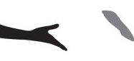

Skills Challenge #22
The skill: In The Bucket
Choose a soft object and target
From 1 step away throw object into bucket
If successful take a step further away and repeat
Keep going until you miss
Record your distance (steps)
Focus on:
Hand Eye
Coordination – Accuracy
Personal Best: Challenge
Vs Challenge
3 Attempts | Record your distance |
What is your personal best?
Head to head | 3 attempts each |
Record your distance | Who wins?
 | Number of steps from target
1st Attempt
2nd Attempt
3rd Attempt
Number of steps from target | Player 1 | Player 2 | Winner
1st Attempt
2nd Attempt
3rd Attempt
For more home learning resources, please visit: pescholar.com/home-learning

Slide 5

Skills Challenge #23
Fit in 5
A set of challenges designed to improve a variety of fundamental sports skills. Created for individual use with a personal best challenge or with a friend or family member in a head to head. These skills challenges are aimed at 6-14 year olds but are fun for any age!
The purpose of each challenge is to improve skills in a fun, enjoyable way.
Each challenge has a skill component focus
Skills Challenge #23 Focus: Cardiovascular endurance
Skills Challenge #23 Fit in 5
The rules:
Complete the 5 activity work out | 60 seconds per activity | No breaks | Record your total score (reps)| Repeat each day | try to increase your total score
Personal Best: Try to score the more reps each day
Vs: Play against someone, highest score (number of reps) in 5 minutes wins
For extra challenge, increase the time for each activity or change the activities to suit you
For more home learning resources, please visit: pescholar.com/home-learning

Slide 6

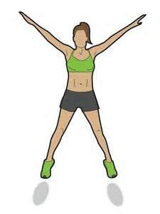
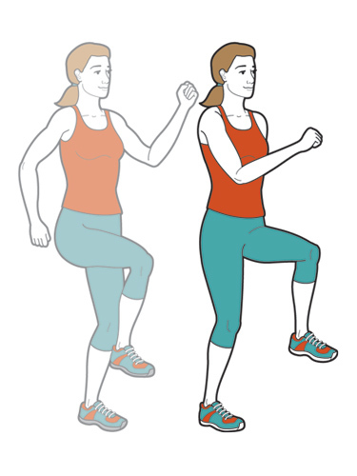
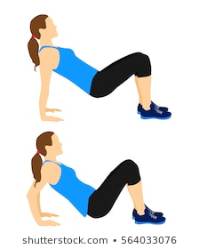
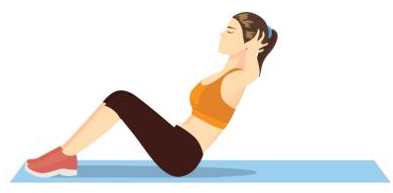
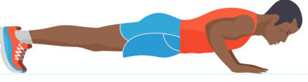
Skills Challenge #23
The skill: Fit in 5
et up two cones/objects
Complete 5 activities
60 Seconds per activity, no breaks
Record your total score (Reps)
Repeat each day
Focus on: Cardiovascular endurance
5 Days| Record your total score|
What is your best day?
Activity 1 (60 Seconds) | Activity 2 (60 Seconds) | Activity 3 (60 Seconds) | Activity 4 (60 Seconds) | Activity 5 (60 Seconds)
Sit ups | Press ups | Star Jumps | High Knees | Tri Dips
Total Score (Reps)
Day 1
Day 2
Day 3
Day 4
Day 5
Best day:
Personal Best: Challenge
Head to head | Record your scores| Who wins?
Vs Challenge
 | Player 1 Score | Player 2 Score | Winner
Total Score (REPS)
For more home learning resources, please visit: pescholar.com/home-learning

Slide 7
Skills Challenge #24
Golf Roll
A set of challenges designed to improve a variety of fundamental sports skills. Created for individual use with a personal best challenge or with a friend or family member in a head to head. These skills challenges are aimed at 6-14 year olds but are fun for any age!
The purpose of each challenge is to improve skills in a fun, enjoyable way.
Each challenge has a skill component focus.
Skills Challenge #24 Focus: Hand eye coordination – Accuracy
Skills Challenge #24 – Golf Roll
The rules:
Set up a target (cone, stump etc)| Create a course using objects | Try to roll a ball to hit the target in as few a rolls as possible | Record the number of rolls you take
Personal Best: Try to hit the target in as few as rolls possible over 3 attempts
Vs: Play against someone, best of three wins
Use cones or household objects to make your course easier or harder
Create different courses (like crazy golf)
For more home learning resources, please visit: pescholar.com/home-learning

Slide 8
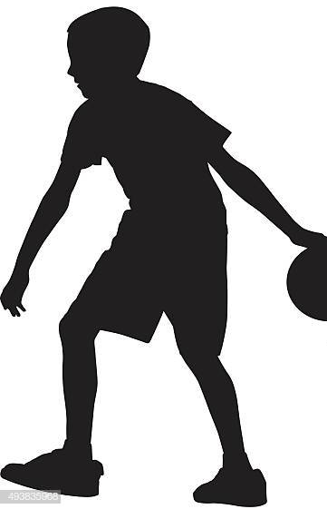
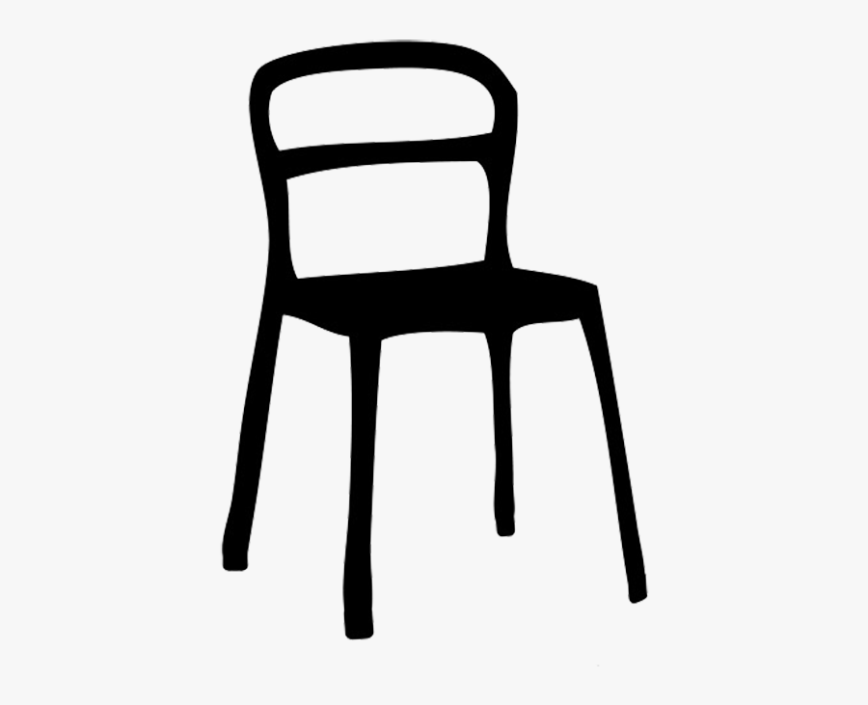


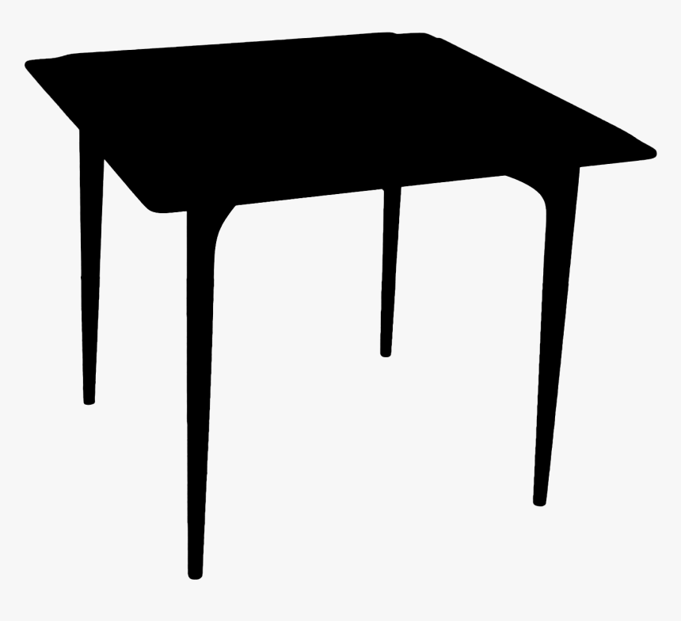
Skills Challenge #24
The skill: Golf Roll
Set out a course with a target and obstacles
Try to hit the target in as fewest rolls
Record the number of rolls
Focus on:
Hand Eye
Coordination – Accuracy
Personal Best: Challenge
3 Attempts| Record your number of rolls
What is your personal best? | Change the course and repeat
Course 1 | Number of rolls
Attempt 1:
Attempt 2:
Attempt 3:
Course 2 | Number of rolls
Attempt 1:
Attempt 2:
Attempt 3:
Head to head| Record your scores
Who wins?
 | Number of rolls | Number of rolls | Winner
Player 1:
Player 2:
Vs Challenge
For more home learning resources, please visit: pescholar.com/home-learning

Slide 9
Skills Challenge #25
Press It Up
A set of challenges designed to improve a variety of fundamental sports skills. Created for individual use with a personal best challenge or with a friend or family member in a head to head. These skills challenges are aimed at 6-14 year olds but are fun for any age!
The purpose of each challenge is to improve skills in a fun, enjoyable way.
Each challenge has a skill component focus
Skills Challenge #25 Focus: Strength
Skills Challenge #25 – Press it up
The rules:
From starting position| Complete as many correct press ups as you can in 90 seconds| Record your score
Personal Best: Try to get your best score over 5 days
Vs : Play against someone, best score wins, best of three
Jump clap press ups to increase challenge
Reduce the time to make the challenge easier
For more home learning resources, please visit: pescholar.com/home-learning

Slide 10
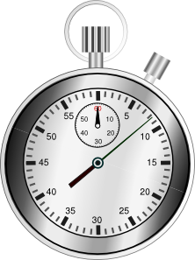
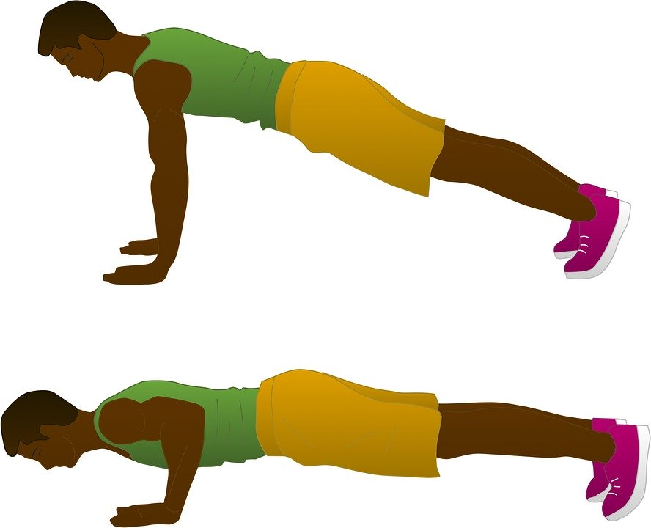
Skills Challenge #25
The skill: Press It Up
1. From sit up position
2. Complete as many press ups as you can
3. In 90 seconds
4. Record your score
Focus on:
Strength
Personal Best: Challenge
5 Days | 90 Seconds|
Record your scores |
What is your personal best?
Number of Press ups
Day 1
Day 2
Day 3
Day 4
Day 5
Head to head | Best of three| Record your scores
Who wins?
 | Player 1 Score: | Player 2 Score: | Winner
1st 90 Seconds
2nd 90 Seconds
3rd 90 Seconds
Vs Challenge
For more home learning resources, please visit: pescholar.com/home-learning

