Slide 1
Skills Challenge #26
Drop | Kick | Catch
A set of challenges designed to improve a variety of fundamental sports skills. Created for individual use with a personal best challenge or with a friend or family member in a head to head. These skills challenges are aimed at 6-14 year olds but are fun for any age!
The purpose of each challenge is to improve skills in a fun, enjoyable way.
Each challenge has a skill component focus.
Skills Challenge #26 Focus: Hand eye coordination
Skills Challenge #26 – Drop | Kick | Catch
The rules:
Using a large type of ball | Drop the ball | Kick the ball into the air | Catch the ball| As many times as you can in 60 seconds | Record your score.
Personal Best: Try to get your best score in 3 attempts
Vs: Play against someone, best of three wins
If you haven’t got a ball you could something in your home that is suitable to throw and catch like a toilet roll.
Agree the time before the game and count if you do not have stop watch
For more home learning resources, please visit: pescholar.com/home-learning

Slide 2
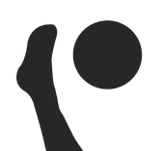

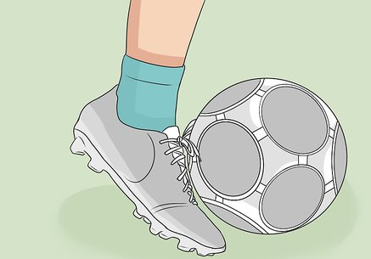
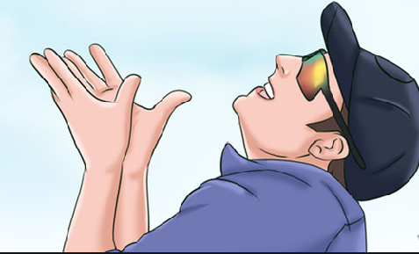
Skills Challenge #26
The skill: Drop | Kick | Catch
Drop the ball
Kick the ball in the air
Catch the ball as many times as you can in 60 seconds
Record your score
Focus on:
Hand Eye Coordination
Personal Best: Challenge
3 Attempts| Record your scores
What is your personal best?
Drop Kick Catch | Your Score
Attempt 1:
Attempt 2:
Attempt 3:
Vs Challenge
Head to head| Record your scores
Who wins?
Drop Kick Catch | Your Score | Winner
Player 1:
Player 2:
For more home learning resources, please visit: pescholar.com/home-learning

Slide 3
Skills Challenge #27
The 1 Hand Plank
A set of challenges designed to improve a variety of fundamental sports skills. Created for individual use with a personal best challenge or with a friend or family member in a head to head. These skills challenges are aimed at 6-14 year olds but are fun for any age!
The purpose of each challenge is to improve skills in a fun, enjoyable way.
Each challenge has a skill component focus
Skills Challenge #27 Focus: Power
Skills Challenge #27 –The 1 hand plank
The rules:
From 1 hand plank position| Hold the correct position as long as possible| Record your time each day | Do you improve?
Personal Best: Try to get your longest time over 5 days
Vs: Play against someone, longest time wins
For extra challenge, research and try side planks.
For more home learning resources, please visit: pescholar.com/home-learning

Slide 4
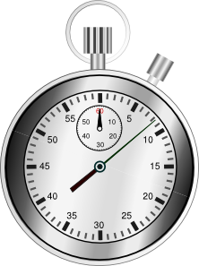
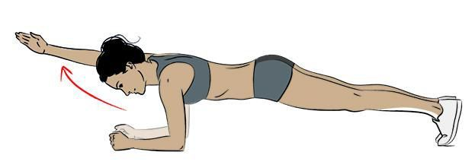
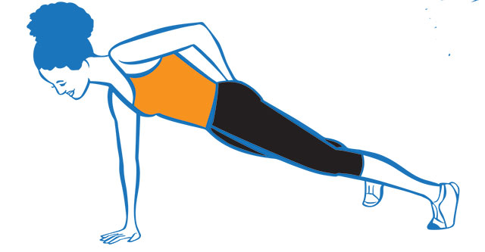
Skills Challenge #27
The skill: The 1 Hand Plank
From plank position
Hold the correct position for as long as possible
Record your time daily, Do you improve?
Focus on: Power
Daily Attempt | Record your times |
What is your best day?
1 hand Plank Daily (time in seconds)
Monday
Tuesday
Wednesday
Thursday
Friday
Personal Best: Challenge
Head to head | Record your scores| Who wins?
 | Player 1 Time | Player 2 Time | Winner
1 Hand Plank
Vs Challenge
For more home learning resources, please visit: pescholar.com/home-learning

Slide 5
Skills Challenge #28
Jumpin’ Jack Flash
A set of challenges designed to improve a variety of fundamental sports skills. Created for individual use with a personal best challenge or with a friend or family member in a head to head. These skills challenges are aimed at 6-14 year olds but are fun for any age!
The purpose of each challenge is to improve skills in a fun, enjoyable way.
Each challenge has a skill component focus
Skills Challenge #28 Focus: Cardiovascular Endurance
Skills Challenge #28 – Jumpin’ Jack Flash
The rules:
From starting position| Complete as many Jumping Jacks as you can in 90 seconds| Record your score
Personal Best: Try to get your best score over 5 days
Vs : Play against someone, best score wins, best of three
Increase or reduce the time to make the challenge harder or easier
For more home learning resources, please visit: pescholar.com/home-learning

Slide 6
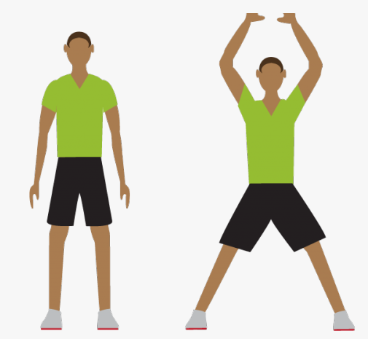
Skills Challenge #28
The skill: Jumping Jacks
1. From start position
2. Complete as many press ups as you can
3. In 90 seconds
4. Record your score
Focus on:
Cardiovascular
Endurance
Personal Best: Challenge
5 Days | 90 Seconds|
Record your scores |
What is your personal best?
Number of Jumping Jacks
Day 1
Day 2
Day 3
Day 4
Day 5
Head to head | Best of three| Record your scores
Who wins?
 | Player 1 Score: | Player 2 Score: | Winner
1st 90 Seconds
2nd 90 Seconds
3rd 90 Seconds
Vs Challenge
For more home learning resources, please visit: pescholar.com/home-learning

Slide 7
Skills Challenge #29
Balance 8
A set of challenges designed to improve a variety of fundamental sports skills. Created for individual use with a personal best challenge or with a friend or family member in a head to head. These skills challenges are aimed at 6-14 year olds but are fun for any age!
The purpose of each challenge is to improve skills in a fun, enjoyable way.
Each challenge has a skill component focus
Skills Challenge #28 Focus: Balance and Agility
Skills Challenge #28 – Balance 8
The rules:
Set up two cones/objects a small distance apart| Balance a bean bag or soft object on your head| Walk around the cones in a figure of 8 balancing the object | Count as many times as you can without dropping the object| Record your score each day
Personal Best: Try to get your best score time over 5 attempts
Vs: Play against someone, most laps win
For extra challenge, change the size of your course.
For more home learning resources, please visit: pescholar.com/home-learning

Slide 8
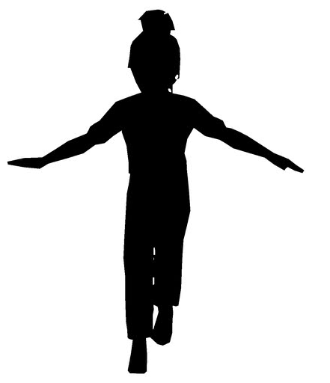
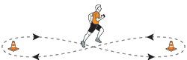
Skills Challenge #29
The skill: Balance 8
1. Set up a two object course
2. Balance an object on head
3. Complete as many laps as you can without
dropping the object
4. Record your score
Focus on: Balance
and agility
5 Attempts | Record your laps |
What is your best day?
Vs Challenge
Number of laps
1st Attempt
2nd Attempt
3rd Attempt
4th Attempt
5th Attempt
Head to head | Record your scores| Who wins?
Personal Best: Challenge
 | Player 1 Score | Player 2 Score | Winner
Number of laps
For more home learning resources, please visit: pescholar.com/home-learning

Slide 9
Skills Challenge #30
Jump up
A set of challenges designed to improve a variety of fundamental sports skills. Created for individual use with a personal best challenge or with a friend or family member in a head to head. These skills challenges are aimed at 6-14 year olds but are fun for any age!
The purpose of each challenge is to improve skills in a fun, enjoyable way.
Each challenge has a skill component focus
Skills Challenge #29 Focus: Speed, agility and power
Skills Challenge #29 – Jump up
The rules:
Choose a step | jump up two footed| jump down two footed |Complete as many as you can in 60 seconds| Record your score
Personal Best: Try to get your best score over 3 attempts
Vs : Play against someone, best score wins, best of three
Increase the size of your steps for a greater challenge
Use your bottom stair in your house as an alternative to a step
For more home learning resources, please visit: pescholar.com/home-learning

Slide 10
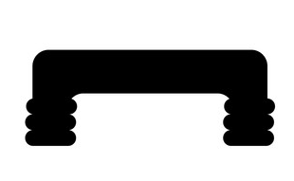
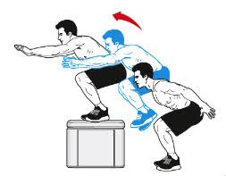
Skills Challenge #30
The skill: Jump Up
1. Choose a step
2. Step up and down
3. As many times as you can in 60 seconds
4. Record your score
Focus on:
Speed, agility
and power
Personal Best: Challenge
3 Attempts | 60 Second jumps|
Record your scores
What is your personal best?
 | Score:
1st 60 Seconds
2nd 60 Seconds
3rd 60 Seconds
Head to head | Best of three| Record your scores
Who wins?
 | Player 1 Score: | Player 2 Score: | Winner
1st 60 Seconds
2nd 60 Seconds
3rd 60 Seconds
Vs Challenge
For more home learning resources, please visit: pescholar.com/home-learning

Slide 11
Skills Challenge #31
Arabesque Balance
A set of challenges designed to improve a variety of fundamental sports skills. Created for individual use with a personal best challenge or with a friend or family member in a head to head. These skills challenges are aimed at 6-14 year olds but are fun for any age!
The purpose of each challenge is to improve skills in a fun, enjoyable way.
Each challenge has a skill component focus
Skills Challenge #30 Focus: Strength and balance
Skills Challenge #30 – Arabesque Balance
The rules:
From arabesque start position| Hold the correct position as long as possible| Record your time each day | Do you improve?
Personal Best: Try to get your longest time over 5 days
Vs: Play against someone, longest time wins
For extra challenge, research and try other 1 legged positions.
For more home learning resources, please visit: pescholar.com/home-learning

Slide 12
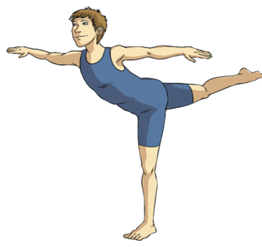
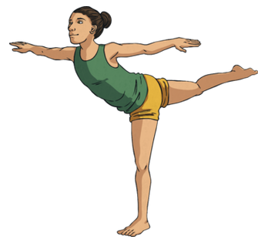
Skills Challenge #31
The skill: Arabesque Balance
From start position
Hold the correct position for as long as possible
Record your time daily, Do you improve?
Focus on:
Strength
and balance
Daily Attempt | Record your times |
What is your best day?
Arabesque Daily (time in seconds)
Monday
Tuesday
Wednesday
Thursday
Friday
Personal Best: Challenge
Head to head | Record your scores| Who wins?
 | Player 1 Time | Player 2 Time | Winner
Arabesque Balance
Vs Challenge
For more home learning resources, please visit: pescholar.com/home-learning

