Slide 1
Summer Sport Challenge 6 Weeks, 6 Sports, 6 Personal Bests!
This resource contains a set of 6 sporting event resource cards. It has been designed for the 6 week Summer Holidays with a different challenge each week. Each event is linked to a sporting target and allows you to reach the target and in some cases exceed it. Please adapt accordingly for your needs!
This resource has been designed to be used once per week.
Please use the resource in whichever order you prefer
More that one activity can be completed each week and therefore revisited
You could use the same activity each week and try to better your weekly score
Included with the resource:
6 Event cards, one for each activity:
Marathon step challenge
Exercise 200
Ball skills
Catch it
Climb Snowdon
Duathlon
For more home learning resources, please visit: pescholar.com/home-learning

Slide 2
Summer Sport Challenge 6 Weeks, 6 Sports, 6 Personal Bests!
Week 1 Marathon Step Challenge
Week 2
Exercise 200
Week 3
Ball Skills
Week 4
Catch It
Week 5
Climb Snowdon
Week 6
Duathlon
For more home learning resources, please visit: pescholar.com/home-learning

Slide 3
Summer Sport Challenge Week 1
Week 1 Marathon Step Challenge
The average steps to complete a marathon is 63000!
Can you complete one in a week or quicker?
Using a step counter app or watch
You need to complete at least 9000 per day
Each day record your steps
How quickly can you get to 63000?
What is your total steps for the week?
 | Day 1 | Day 2 | Day 3 | Day 4 | Day 5 | Day 6 | Day 7 | Total steps
Number of steps
For more home learning resources, please visit: pescholar.com/home-learning

Slide 4
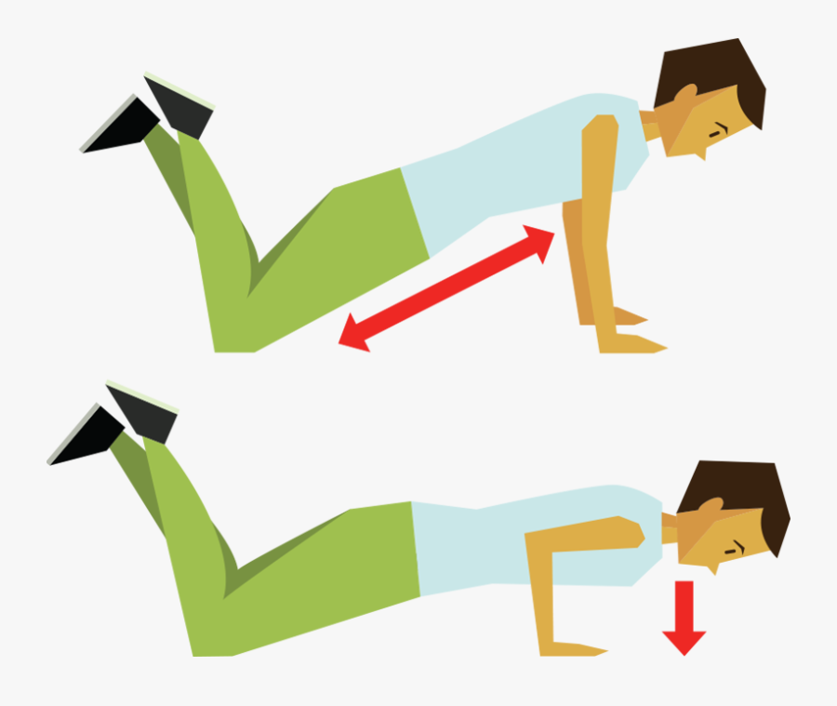
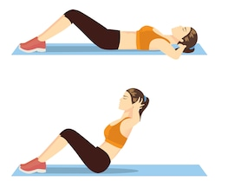
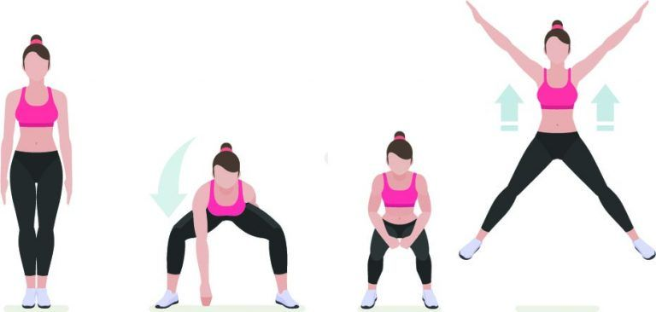
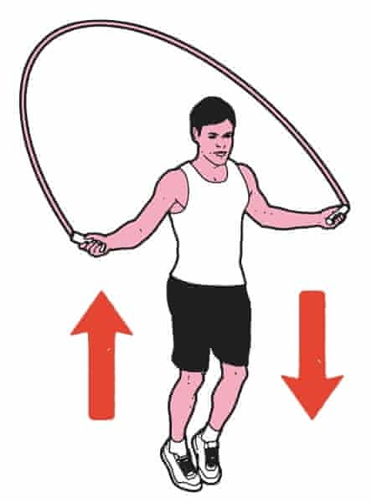
Summer Sport Challenge Week 2
Week 2 Exercise 200
Can you complete 200 reps in a week?
Choose an exercise from the list below
Each day complete the number of reps required
 Each day as you go
 When you’ve completed 200
Press up
Box Press up
Sit up
Touch ground star jump
Skipping
 | Day 1 | Day 2 | Day 3 | Day 4 | Day 5 | Day 6 | Day 7 | Total
To complete each day | 12 Reps | 15 Reps | 20 Reps | 26 Reps | 34 Reps | 40 Reps | 53 Reps | 200 Reps
Exercise __________ 
For more home learning resources, please visit: pescholar.com/home-learning

Slide 5
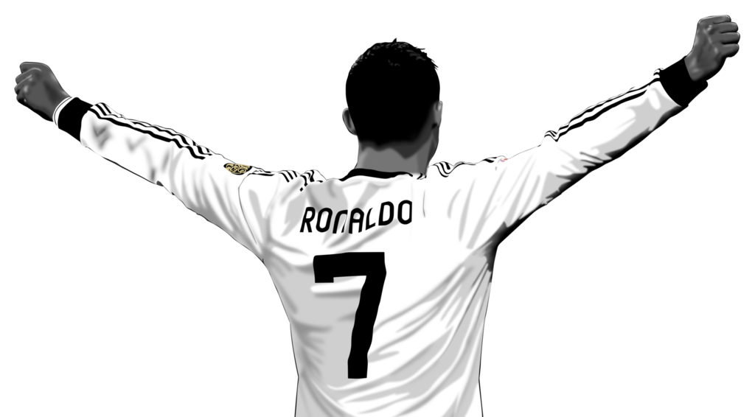
Summer Sport Challenge Week 3
Week 3 Ball Skills
Ronaldo has scored 55 free kicks in his career
Can you do it in a week?
Set up a cone or target
Using a ball of your choice
Try to kick the ball to hit the cone or target from different distances and angles
Record your scores each day
Can you get 55 or more in a week?
Day | Number of hit targets
Day 1
Day 2
Day 3
Day 4
Day 5
Day 6
Day 7
Total target hits
For more home learning resources, please visit: pescholar.com/home-learning

Slide 6
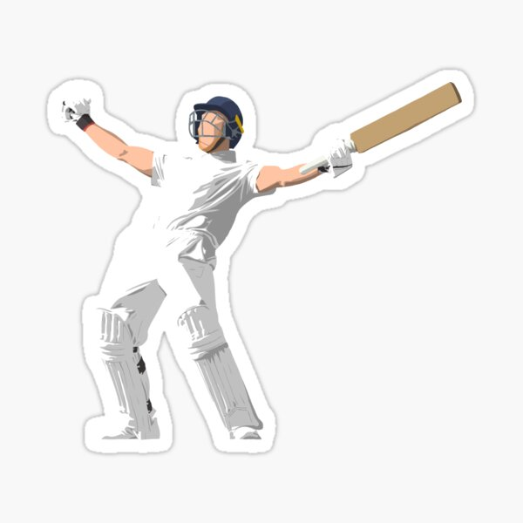
Summer Sport Challenge Week 4
Week 4 Catch it
Ben Stokes has caught 130 catches for England
Can you do it in a week?
Ask a family member or friend to help
Use a ball of your choice
Ask your partner to throw the ball to you at different heights and angles
Catch the ball as many times as you can in a row each day
Record your scores
Day | Number of catches
Day 1
Day 2
Day 3
Day 4
Day 5
Day 6
Day 7
Total catches
For more home learning resources, please visit: pescholar.com/home-learning

Slide 7
Summer Sport Challenge Week 5
Week 5
Climb Snowdon
Can you complete 4613 steps to conquer Snowdonia?
Use the stairs in your house (approx. 14 steps)
You need to complete at least 660 steps per day
That’s 47 times up your stairs each day
Each day record your steps
How quickly can you get to 4614 steps?
What is your total steps for the week?
 | Day 1 | Day 2 | Day 3 | Day 4 | Day 5 | Day 6 | Day 7 | Total steps
Number of steps
For more home learning resources, please visit: pescholar.com/home-learning

Slide 8
Summer Sport Challenge Week 6
Week 6 Duathlon
The average duathlon takes 210 minutes to complete
Using running and cycling can you complete one in a week?
Each day choose a run or cycle
Time how long (in minutes) you run or cycle for
Record your daily minutes
How many days can you complete a duathlon in?
What is your total minutes achieved in a week?
 | Day 1 | Day 2 | Day 3 | Day 4 | Day 5 | Day 6 | Day 7 | Total
Number of minutes Cycling or running
For more home learning resources, please visit: pescholar.com/home-learning

