Slide 1
The Mind and Sports Performance
Learning Aims
Investigate personality and its effect on sports performance.
Explore the influence that motivation and self-confidence have on sports performance.
Know about arousal and anxiety, and the effects they have on sports performance.

Slide 2
Scenario
You are one of the coaching staff of a local sports team.
The head coach has discovered that you are studying ‘The Mind and Sports Performance’ and asks you to prepare a range of resources that could be used to help improve the team’s performance.

Slide 3
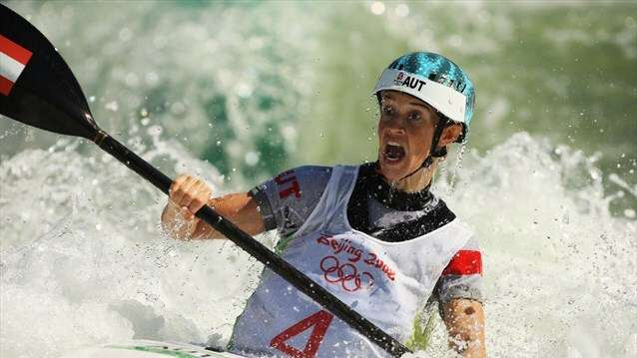
Section A:
Investigate personality and its effect on sports performance.
Notes:
Photo: © London 2012

Slide 4
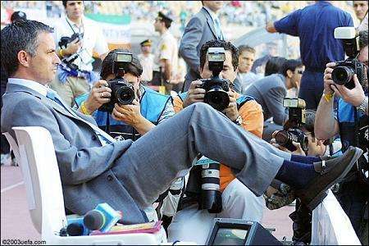
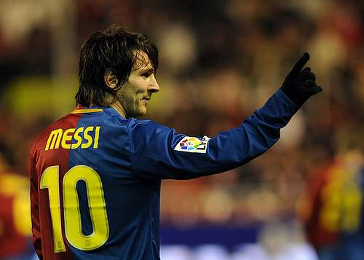
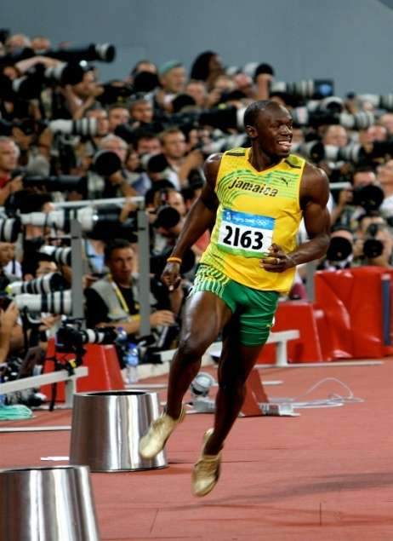
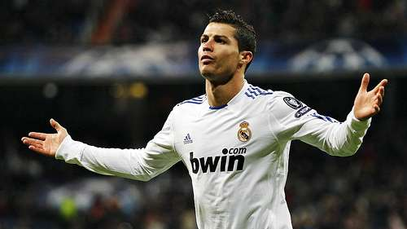
Effect of Personality on Performance
What is the difference in the personality of these athletes?
Notes:
Photo (Messi): © prettyfriendship on Flickr. This image is reproduced under the terms of the Creative Commons License 2.0. http://www.flickr.com/photos/34103436@N06/3176052482/
Photo (Ronaldo): © americanistadechiapas on Flickr. This image is reproduced under the terms of the Creative Commons License 2.0. http://www.flickr.com/photos/americanistadechiapas/5318194617/
Photo (Bolt): © rich115 on Flickr. This image is reproduced under the terms of the Creative Commons License 3.0. http://www.fotopedia.com/items/flickr-2767537621

Slide 5
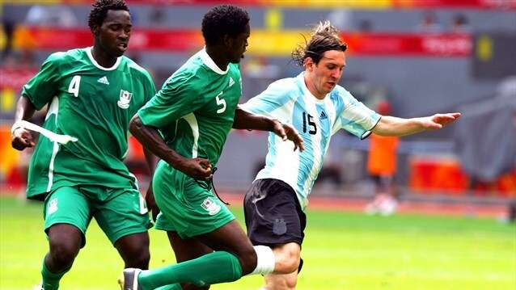
What is Personality?
Personality is the sum of the unique characteristics that make a person. Knowledge about personality is important to ensure optimum sporting performance.
Notes:
Photo: © London 2012

Slide 6
Structure of Personality
This diagram shows the structure of personality in individuals.
Role-Related Behaviour
Typical responses
Psychological core

Slide 7
Structure of Personality
Role-Related Behaviour
Typical responses
Psychological core
This encompassing attitudes, values, interests and beliefs.
This is the ‘real you’
e.g. a sportsman’s belief that fair play underlies his attitude on the field of play.
Psychological core
Typical responses
The way in which an individual responds in certain situations. e.g. stopping fighting at the bell.

Slide 8
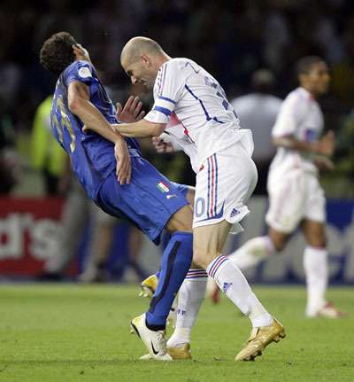
Structure of Personality
Role related behaviour
Changes in behaviour occur as perception of the situation changes. Different situations require different roles.
e.g. striking after the bell when annoyed or frustrated
Role-Related Behaviour
Typical responses
Psychological core
Notes:
Photo: © Focus Multimedia

Slide 9
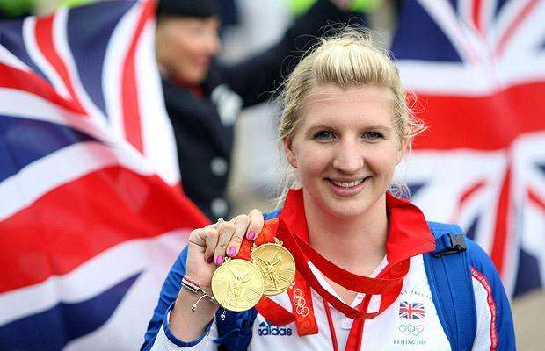
Personality Types
Extrovert & Introvert
Introverts tend to be inward looking and shy and they are comfortable in their own company.
Extroverts tend to be outgoing and comfortable in other people’s company.
Notes:
Photo: © LOCOG London 2012

Slide 10
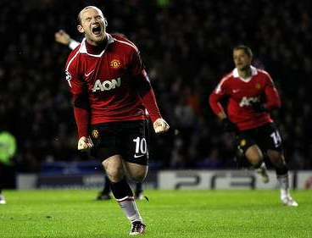
Personality Types
It is suggested that there are two distinct personality types – type A and type B
TYPE A characterised by:
impatience
works at a rapid pace
higher levels of stress
easily aroused
strong desire to succeed
anxiety in stressful situations
lacking in tolerance
has a need to be in control
makes decisions quickly
Notes:
Photo: © americanistadechiapas on Flickr. This image is reproduced under the terms of the Creative Commons License 2.0. http://www.flickr.com/photos/americanistadechiapas/5284558112/

Slide 11
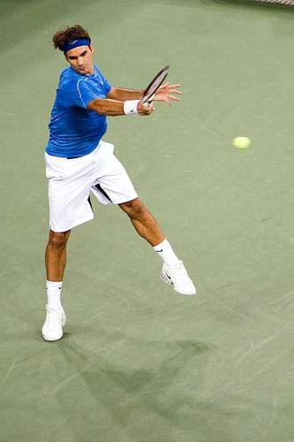
Personality Types
TYPE B characterised by:
relaxed and patient
allow time for tasks to be completed
tolerance of others’ mistakes
delegates easily
low personal stress
calm and unflappable in most situations
less competitive
prepared to wait and assess all options when decisions need to be made
Notes:
Photo: © toga on Flickr. This image is reproduced under the terms of the Creative Commons License 3.0. http://www.flickr.com/photos/14622025@N00/511921542

Slide 12
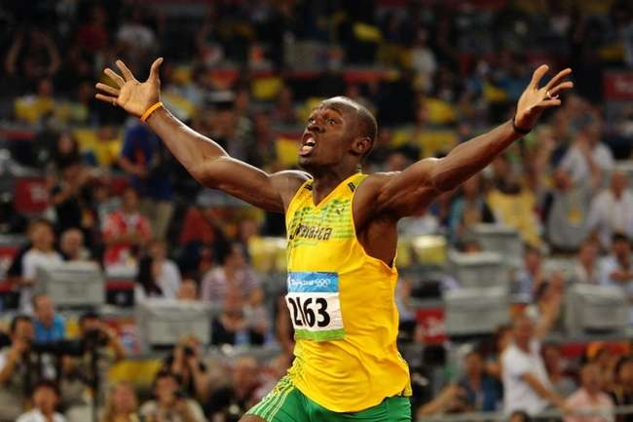
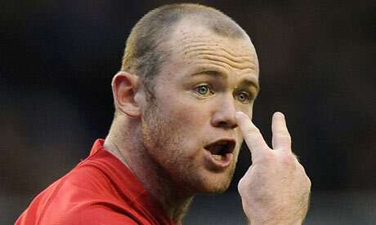
Personality Types
Different personalities are best suited to certain sports. What type of personality is needed for the following sports?
Golf
Athletics
Archery
Volleyball
Canoeing
Judo
Notes:
Photo (Rooney): © Focus Multimedia
Photo (Bolt): © London 2012

Slide 13
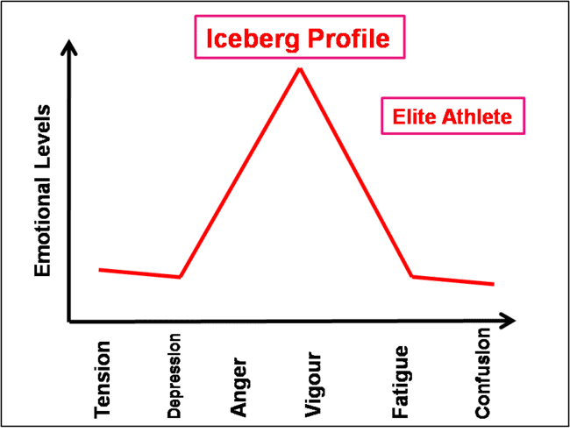
Measuring Personality
Profile of Mood States
Moods are an important aspect of personality which may influence sports performance. Mood states were said to be temporary and change with each situation.
There are 6 mood states that exist in an athlete:
tension
depression
anger
vigour
fatigue
confusion
Notes:
Photo: © PE Resources Bank

Slide 14
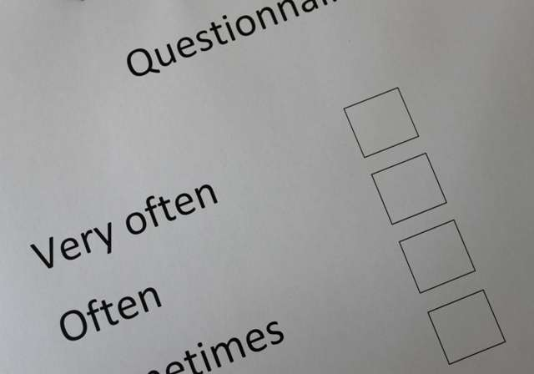
Measuring Personality
There are other ways to measure an individuals personality.
Questionnaires – Eysenck’s Personality Inventory
These questions must be answered honestly and fairly and can be carried out before or after the event.
Notes:
Photo: © PE Resources Bank

Slide 15
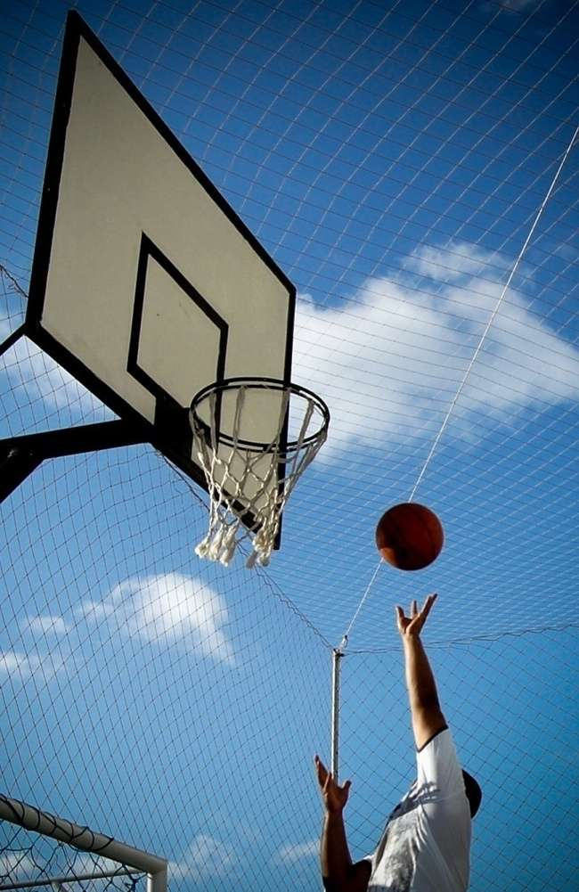
Measuring Personality
Observations – This involves watching the performer’s behaviour over time.
Observations: Are made during an actual event and directly relate to the performance.
Problems with observations:
difficult to quantify accurately
may be influenced by the observer’s views and attitudes.
Notes:
Photo: © Stock.xchng. http://www.sxc.hu/photo/887983

Slide 16
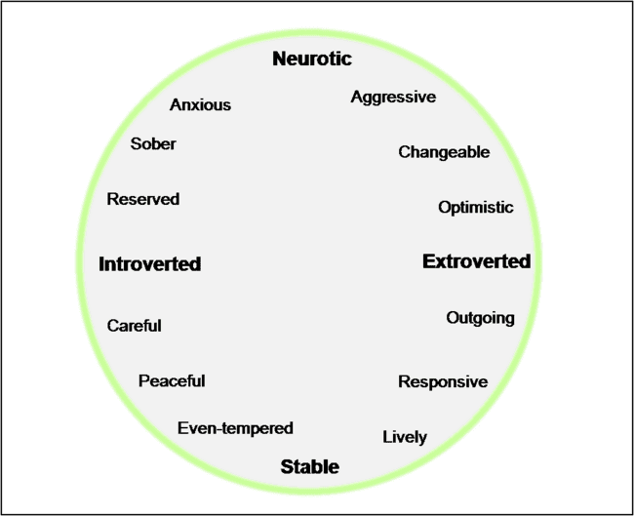
Views of Personality – Trait Theory
What type of personality are you?
Notes:
Photo: © PE Resources Bank

Slide 17
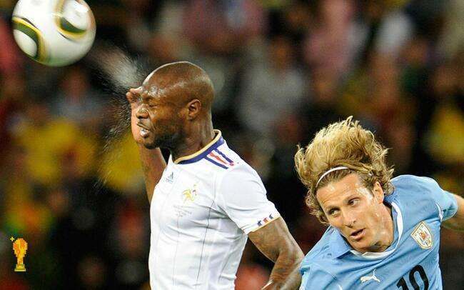
Views of Personality
Trait Theory
This theory suggests that personalities are:
general (covering all situations)
underlying (inside of and part of the person)
This is why some people behave in certain ways across many situations
Notes:
Photo: © deshow.net

Slide 18
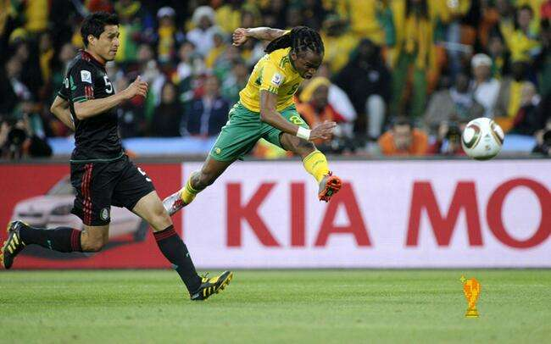
Views of Personality – Situational Theory
This theory suggests that all behaviour is learned through interaction with the environment and that inherited factors do not influence personality.
Therefore, the response made by an individual cannot be predicted.
e.g. a young football player observes a senior player intimidating opponents through hard and aggressive tackling.
Notes:
Photo: © deshow.net

Slide 19
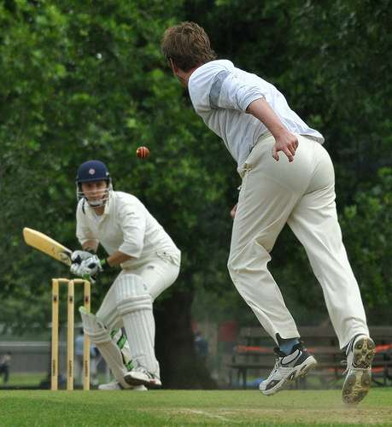
Views of Personality – Interactionist Theory
The interactionist theory states behaviour is a combination of both the person’s personality and the situation.
This approach considers both inherited characteristics and the environmental influences in the development of personality.
This theory is the most popular.
Notes:
Photo: © nthairu on Flickr. This image is reproduced under the terms of the Creative Commons License 2.0.
http://www.flickr.com/photos/nthairu/6930957627/sizes/m/in/pool-53326846@N00/

Slide 20
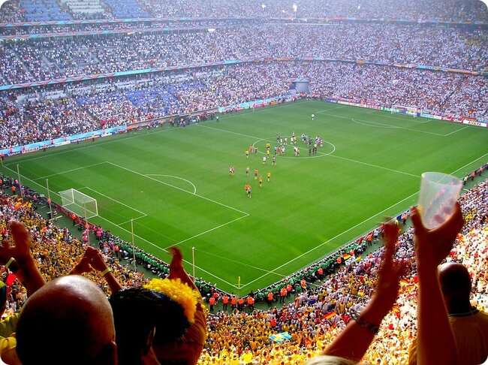
Personality – Interactionist Theory
This approach may explain why we change our behaviour from one moment to the next
How might behaviour change as a result of environmental factors?
Presence of a crowd
Derby matches
Result is of great importance
Provoked by the opposition.
Notes:
Photo: © IsakAronsson on flickr. This image is reproduced under the terms of the Creative Commons License 2.0. http://www.fotopedia.com/items/flickr-2118102579

Slide 21
Section A: Assignment Task
Task A:
Prepare and present a Powerpoint highlighting information on personality that could be used to help improve the team’s performance.
Check your Assignment Booklet
for the Assessment Criteria

Slide 22
Methods you could use to complete Unit 3:
Presentation on personality, views of personality and effects on sports performance
Presentation slides
Supporting notes
Observation record

Slide 23
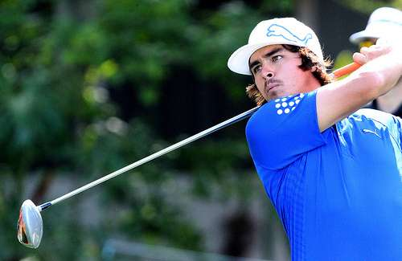
Section B:
Explore the influence that motivation and self-confidence have on sports performance
Notes:
Photo: © keith allison on Flickr. This image is reproduced under the terms of the Creative Commons License 2.0.
http://www.flickr.com/photos/keithallison/6919710690/sizes/m/in/photostream/

Slide 24
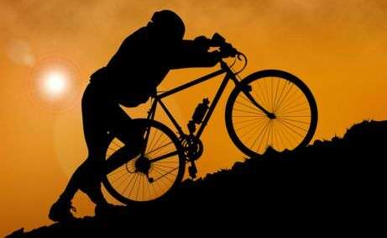
Motivation
What is motivation? Brainstorm for 2 minutes....
Notes:
Photo: © clipart 2012

Slide 25
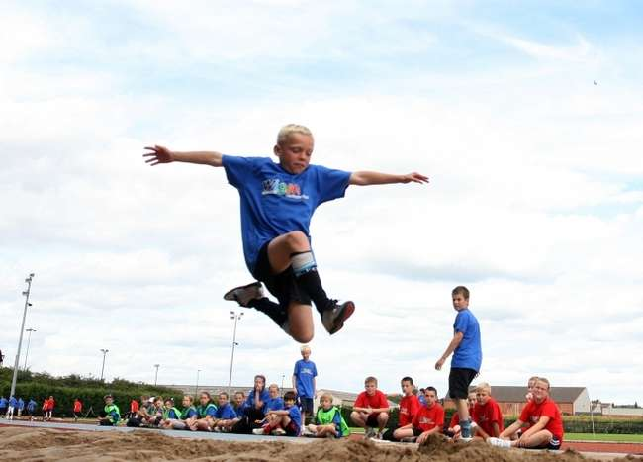
Motivation
What is motivation?
Desire to succeed.
Drive to achieve a goal.
Something that directs behaviour.
Enables a person to focus or concentrate on a particular task.
Defintion:
‘the internal mechanisms and external stimuli that arouse and direct behaviour’
Notes:
Photo: © London 2012

Slide 26
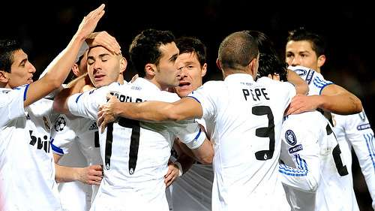
Intrinsic Motivation
Intrinsic motivation include the thrill of scoring a goal, the satisfaction of winning a major competition.
The feeling of well-being derived from such motivation ensures that the performer maintains the desire to continue with the activity.
Notes:
Photo: © americanistadechiapas on Flickr. This image is reproduced under the terms of the Creative Commons License 3.0. http://www.flickr.com/photos/americanistadechiapas/5505292360/

Slide 27
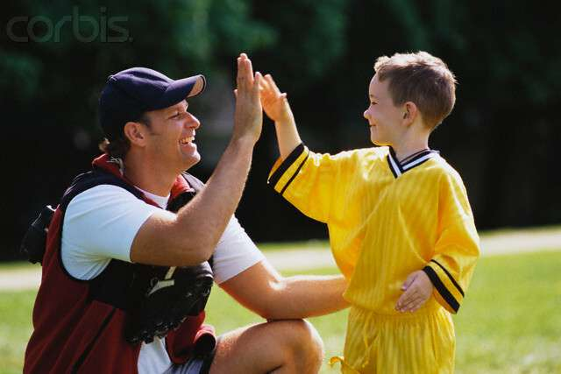
Extrinsic Motivation
Extrinsic motivation is more temporary. It includes both tangible and intangible rewards from an outside source.
Intangible rewards are non-physical, such as the praise and encouragement given by the coach to a beginner who has performed well.
i.e. Performed a personal best time or scored a great goal
Notes:
Photo: © corbis

Slide 28
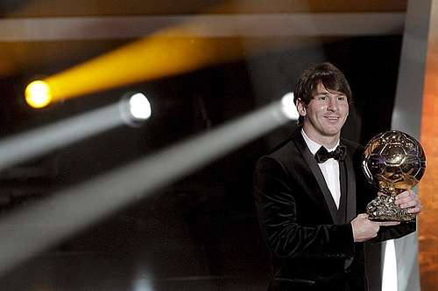
Extrinsic Motivation
Tangible rewards include the medals and trophies that are awarded to players at the end of the season.
Certificates given to young swimmers to mark progression or the money on offer to professional players when they sign a new contract.
Notes:
Photo: © americanistadechiapas on Flickr. This image is reproduced under the terms of the Creative Commons License 2.0. http://www.flickr.com/photos/americanistadechiapas/5365354123/Photo: © 123RF Limited

Slide 29
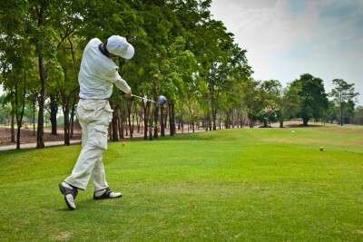
Views of Motivation
Trait Centred: This is the thought that motivation comes from an individual’s personality.
Some people are naturally more driven to succeed than others.
Notes:
Photo: © 123RF Limited

Slide 30
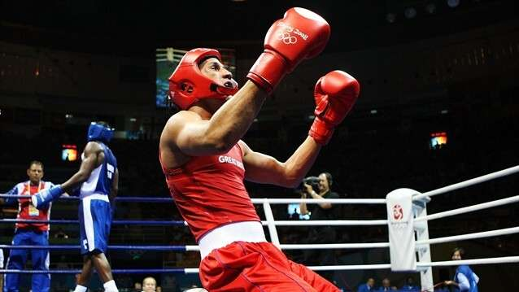
Views of Motivation
Situation Centred: This is the theory that motivation is determined by the situation an individual finds themselves in.
i.e. A championship fight may motivate an athlete to perform at a high level.
Notes:
Photo: © London 2012

Slide 31
Views of Motivation
Interactional: This considers BOTH the individual’s personality and the environment they are in.
This is the most reliable theory to explain motivation.
Notes:
Photo: © London 2012

Slide 32
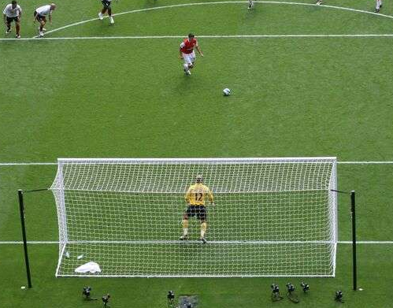
Achievement Motivation
Some people are more willing to place themselves regularly in situations where achievement is compared or evaluated against others.
Definition:
‘an individual’s efforts to master a task, achieve excellence, overcome obstacles and perform better than others’
Notes:
Photo: © roubicek on Flickr. This image is reproduced under the terms of the Creative Commons License 3.0. http://www.fotopedia.com/items/flickr-1094747626

Slide 33
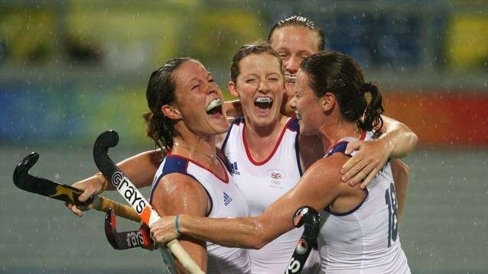
Motivation and performance
Motivation affects the amount of effort that a player puts into the game and players with a strong will to win are usually more successful.
Teams will benefit from have players that fight hard and are well motivated even when losing.
Notes:
Photo: © London 2012

Slide 34
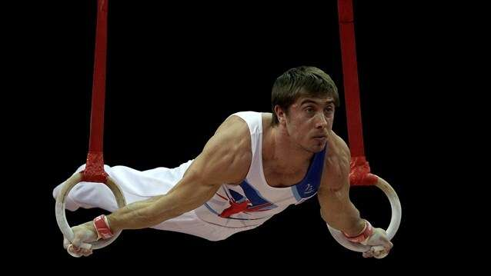
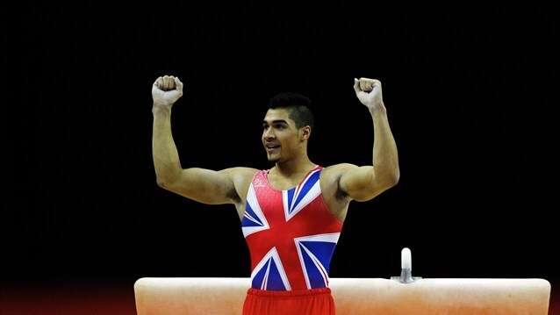
Motivation and performance
Players who are highly motivated will show a number of key characteristics:
Choice of activity
Effort to pursue goals
Intensity of effort
Persistence in adversity.
Notes:
Photo: © London 2012

Slide 35
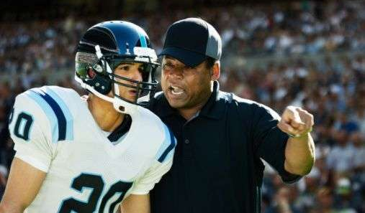
Increasing motivation
What ways can coaches motivate players?
Discuss and brainstorm...
Notes:
Photo: © FocusMedia

Slide 36
Goal setting to increase and direct motivation
Goal setting is a important part of motivation. Targets should be set using the S.M.A.R.T.E.R. principle.
S Specific – must to the point.
M Measureable – can be measured and compared.
A Achievable – challenging.
R Realistic – matched to the performers skill level.
T Time bound – set for a particular time to be completed by.
E Exciting – goals should energise the athlete.
R Recorded– record the targets down in a diary.

Slide 37
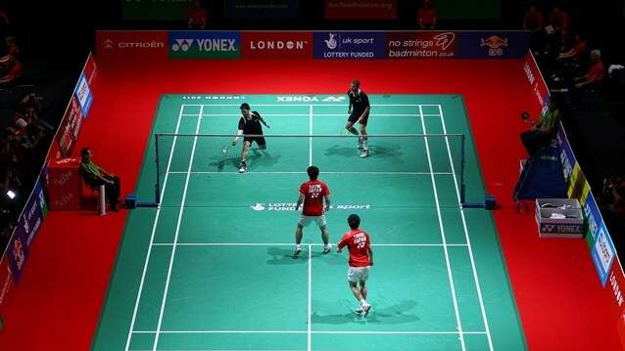
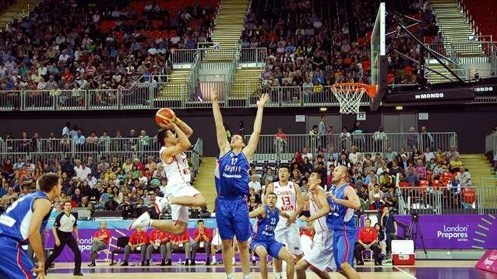
Self-Confidence
Self confidence is a measure of how successful an athlete feels they are to be. High confidence can help a performer to succeed at a task.
Definition:
‘The belief that a desired behaviour can be performed’
Notes:
Photo: © London 2012

Slide 38
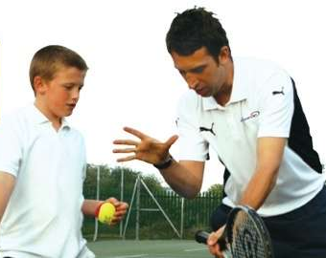
Self-Confidence
High levels of self confidence can promote:
Positive emotions
Concentration levels
Effort levels
Development of positive game plans.
Notes:
Photo: © FocusMedia

Slide 39
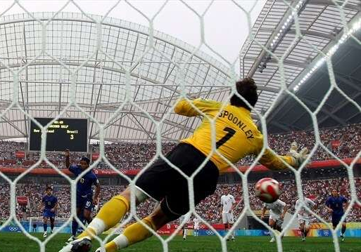
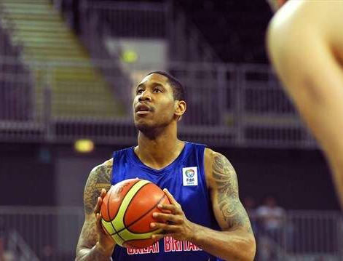
Methods to increase self-confidence
There are a number of techniques and strategies that have been developed to increase self confidence in sport.
Notes:
Photo: © London 2012

Slide 40
Self Talk
This is talking to oneself in a positive way, telling yourself that you will be successful.
e.g. Telling yourself during a competition that you can win or ‘focus’
Notes:
Photo: © americanistadechiapas on Flickr. This image is reproduced under the terms of the Creative Commons License 2.0. http://www.flickr.com/photos/americanistadechiapas/5639051871/

Slide 41
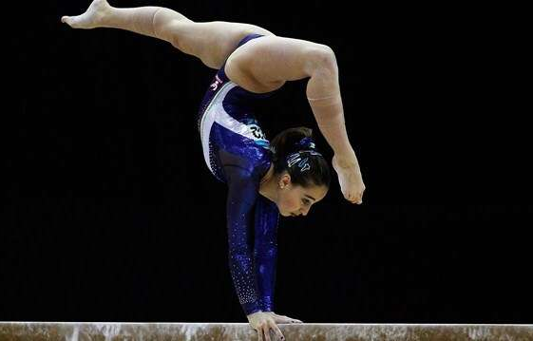
Imagery
This is the formation of mental pictures of successful performances. Performers will recreate confident times and remember what it felt like to win in that situation.
Specific sporting situations can use imagery more readily than others.
i.e. A gymnastics routine
Notes:
Photo: © London 2012

Slide 42
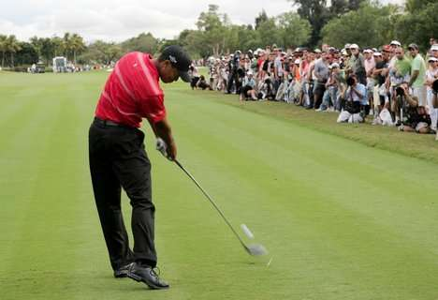
Self Efficacy
People become competent in particular skills and situations. As a result they develop a feeling of self efficacy.
Definition:
“Self efficacy is self confidence in a specific situation”
Notes:
Photo: © Focusmedia

Slide 43
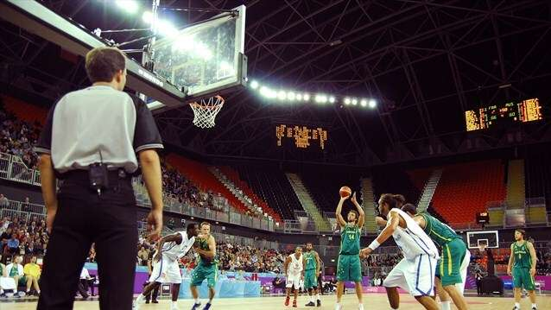
Self Efficacy
TASK: Write down 6 different sports in which you have participated in. Then rank them in order (1 highest) according to your personal level of self efficacy.
What reasons are there for the 2 at the top and the difference between the 2 at the bottom.
Notes:
Photo: © London 2012

Slide 44
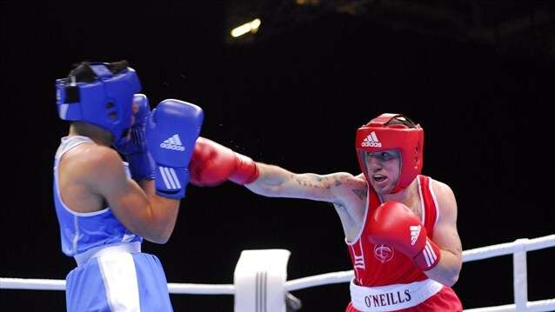
Self Efficacy
What factors could affect an individual’s level of self efficacy?
Notes:
Photo: © London 2012

Slide 45
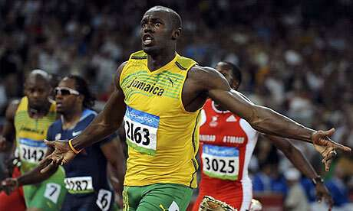
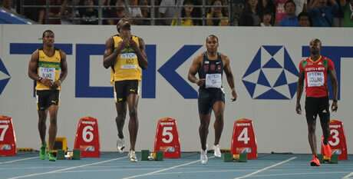
Factors Affecting Self Efficacy
1. Performance accomplishments – These probably have the strongest influence on self confidence. If success has been experienced in the past, then feelings of self confidence are likely to be high
Notes:
Photo: © London 2012

Slide 46
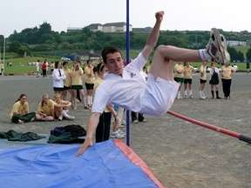
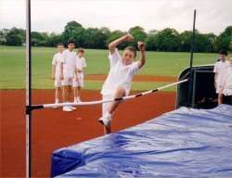
Factors Affecting Self Efficacy
2. Vicarious experiences – This refers to what we have observed before. If we watch others perform and be successful, then we are more likely to experience high self efficacy.
Notes:
Photo: © Focusmedia

Slide 47
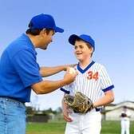
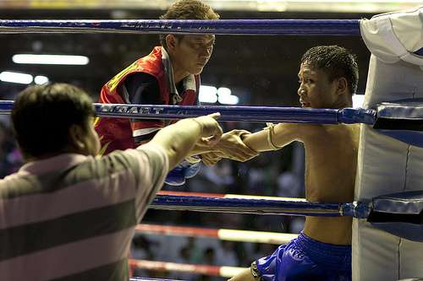
Factors Affecting Self Efficacy
3. Verbal persuasion – If we are encouraged to try a particular activity, our confidence in that situation will increase. This can be from a teacher, coach or peers.
Notes:
Photo: © Focusmedia

Slide 48
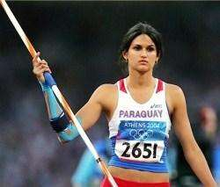
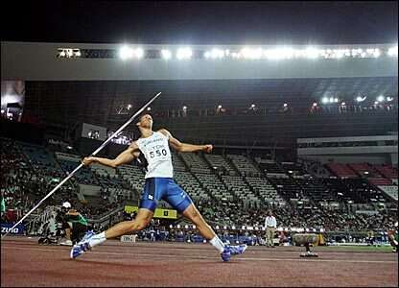
Factors Affecting Self Efficacy
4. Emotional arousal – Our perceptions of how aroused we are can effect our confidence in a particular situation.
Notes:
Photo: © Focusmedia

Slide 49
Goals
Outcome goals: The performance is judged against others and end result. e.g. to win a race/competition.
Notes:
Photo: © London 2012

Slide 50
Goals
Performance goals: Judge performance against his/her own standards. e.g. to beat best time, to have a good start or to maintain an effective breathing action.
Notes:
Photo: © London 2012

Slide 51
Goals
Process goals: Relates to development of specific technique or tactics. e.g. Tighter tumble turn with greater leg drive off the wall in order to improve performance.
Notes:
Photo: © London 2012

Slide 52
Goal Setting
Why do athletes set goals?
Goal setting motivates performers and keeps them working hard. It also directs attention to certain aspects of performance.
Reaching your goals means progress is being made in your training.
Notes:
Photo: © familymwr on Flickr. This image is reproduced under the terms of the Creative Commons License 2.0. http://www.fotopedia.com/items/flickr-5112344521

Slide 53
Goal Setting and motivation
If goals are set correctly, then they can have many other effects:
Provides direction for behaviour
Increased motivation levels
Increased focus
Notes:
Photo: © London 2012

Slide 54
Section B: Assignment Task
Task B:
Design and create a leaflet or handbook with information and details on some materials to help improve your motivation, self-confidence and self-efficacy.
Check your Assignment Booklet
for the Assessment Criteria

Slide 55
Section C:
Know about arousal and anxiety, and the effects they have on sports performance
Notes:
Photo: © deshow.net

Slide 56
Anxiety
Definition for anxiety:
“the level of worry or nervousness an individual experiences”
Stress can have a negative or positive effect on individuals. Everybody differs!!
Notes:
Photo: © deshow.net

Slide 57
Anxiety
There are 2 types of anxiety:
Cognitive (Mental Effects):
Thoughts of worry and concern over perceived lack of ability to complete task. Usually prior to event (Nervousness + apprehension)
Notes:
Photo: © London 2012

Slide 58
Anxiety
Somatic (Physical Effects):
Physiological responses. Increase heart rate, sweating, blood pressure rises, muscle tension. These symptoms usually reduce once the event has started.
Notes:
Photo: © London 2012

Slide 59
Varying levels of somatic and cognitive anxiety
High
Low
Cognitive
Level of anxiety
Somatic
1 week before 1 day 1 hour Start After

Slide 60
Anxiety
There are 2 forms of anxiety that a performer may experience:
Trait Anxiety:
General disposition of a performer to perceive situations as threatening. Naturally anxious individuals will feel apprehensive often.
State Anxiety:
This form of anxiety occurs in particular situation. Linked to performers mood and therefore varies from moment to moment.
e.g. Taking a penalty.
Notes:
Photo: © vivodefutbol on Flickr. This image is reproduced under the terms of the Creative Commons License 3.0. http://www.fotopedia.com/items/flickr-4698936102

Slide 61
Arousal & Anxiety – Drive Theory
This theory suggests that as arousal increase as does performance. The more an individual is aroused the better their performance.
Inverted U Theory
Performance
low
Arousal
high
Notes:
Photo: © PE Resources Bank

Slide 62
Arousal – Inverted U Theory
Inverted U Theory
Performance
low
Arousal
high
How would you interpret this graph?
Notes:
Photo: © PE Resources Bank

Slide 63
Arousal – Inverted U Theory
This theory suggests there is an optimum arousal level.
At low levels of arousal, performance will be below par as the athlete is not psyched up enough.
Inverted U Theory
Performance
low
Arousal
high
Notes:
Photo: © PE Resources Bank
Photo (Golfer): © Stock.xchng . http://www.sxc.hu/photo/1173259

Slide 64
Arousal – Inverted U Theory
As arousal increases so does performance, up to an optimal point. After this point, further increases in arousal lead to declines in performance.
Inverted U Theory
Each athlete has their own optimal level of arousal.
Performance
low
Arousal
high
Notes:
Photo: © PE Resources Bank

Slide 65
Arousal – Catastrophe Theory
How would you interpret this graph?
Notes:
Photo: © PE Resources Bank

Slide 66
Arousal – Catastrophe Theory
This theory proposed performance increases as arousal increases but if arousal gets too high a complete loss of performance occurs. (the catastrophe!)
EXAMPLES?
e.g. the golfer who tries too hard and completely misses the fairway from his drive at the 18th hole when in a winning position.
Notes:
Photo: © PE Resources Bank

Slide 67
Reversal Theory
This theory suggest an iindividual interprets arousal and sees the effect as negative rather than using the feelings to drive performance.
Athlete’s should attempt to interpret arousal as pleasant excitement rather than unpleasant anxiety.
Notes:
Photo: © London 2012

Slide 68
Controlling Anxiety
Imagery/visualisation/Mental Rehearsal:
Formation of mental pictures of successful performances. During IMAGERY the performer will:
Create a vision of calm/tranquil surroundings
Recreate a feeling of a successful movement
Create the sounds and emotional feelings experienced with success

Slide 69
Controlling Anxiety
Relaxation Techniques:
The performer relaxes the chest and shoulder muscles. Deep breathing will redirect attention and reduce anxiety.
Progressive muscle relaxation is also used to controlling anxiety
Notes:
Photo: © PE Resources Bank

Slide 70
Section C: Assignment Task
Task C:
Create a Powerpoint of materials highlighting the types of anxiety and how arousal and anxiety affect sports performance.
Check your Assignment Booklet
for the Assessment Criteria

Slide 71
Methods you could use to complete Unit 3:
Presentation
Presentation slides
Supporting notes
Observation record

