Slide 1
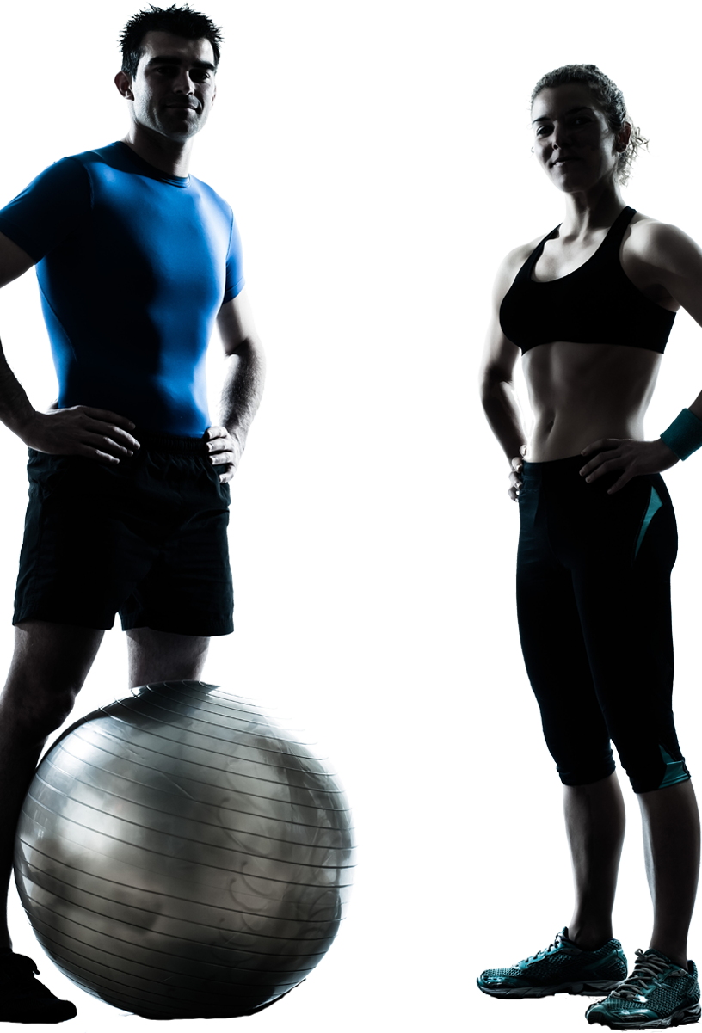
Fitness
Lesson 1 – Core Strength
This Photo by Unknown Author is licensed under CC BY-NC

Slide 2
Do Now – Chat and Interact
How long would you need to exercise for to burn off a Mars bar?
Write your answer in the chat facility NOW!

Slide 3
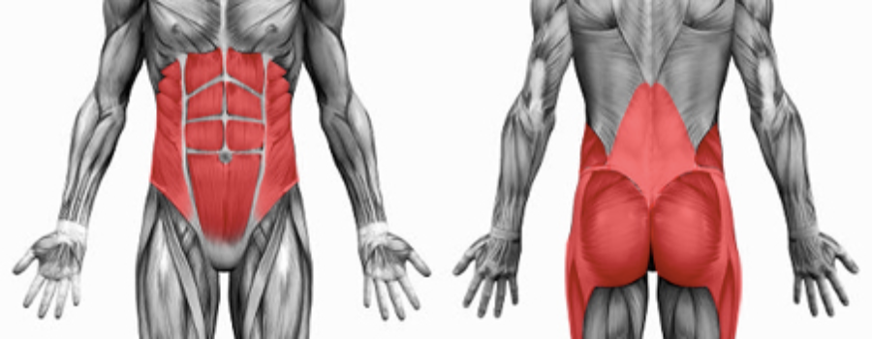
Why is it important?
The strength of the underlying muscles of the torso will help to determine posture.
When the core is weak or inflexible, often the limbs take a lot of the strain related from physical activity.
What muscles make up your core?
What exercises might help build strength in this region?

Slide 4
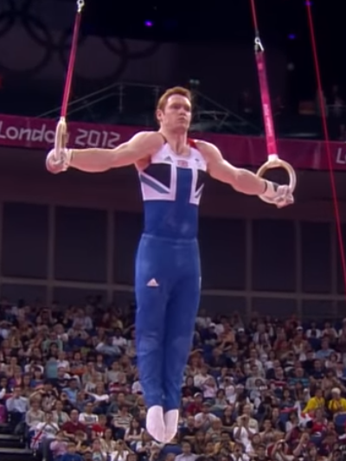
Links to Physical Activity/Sport
One of the most demanding sports on your core is gymnastics – The rings is an event within this.
What other events/sports require a high level of core strength?
Watch me

Slide 5
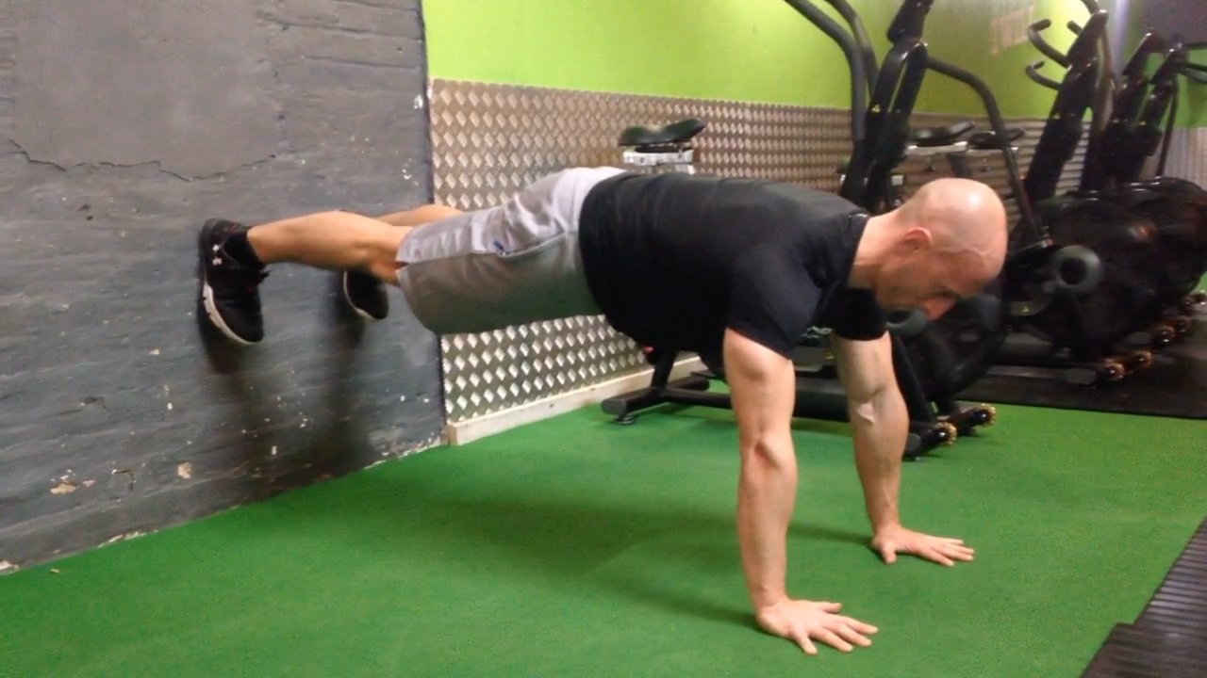
Group Challenge
This will be a virtual group challenge to see who can hold the wall plank for the longest time.
Grab a timer, clear some space around you and identify a wall to use. READY, SET, GO! Log your time. Repeat three times. What was your best time?

Slide 6
Practical – 7-Minute Core Workout
This practical can be done anywhere with a little bit of space around you.
No equipment needed.
12 exercises
Complete as many repetitions as possible in the 30 seconds.

Slide 7
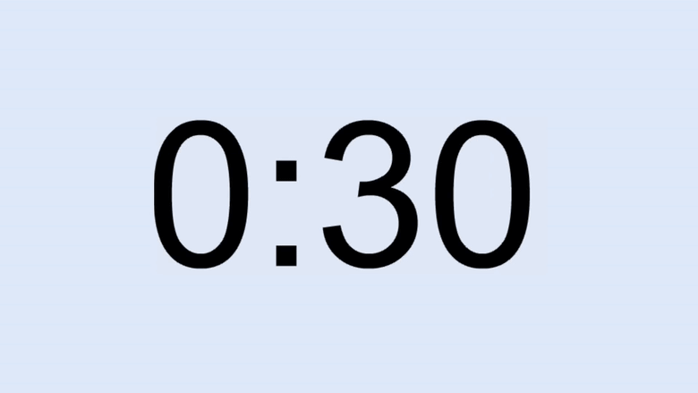
Ready, Set, Go!

Slide 8
Plenary
How might core strength benefit a netballer?
How did you find the core workout?

Slide 9
Fitness
Lesson 2 – Speed
This Photo by Unknown Author is licensed under CC BY-NC

Slide 10
Do Now – Chat and Interact
What is the fastest speed recorded by a human running?
Write your answer in the chat facility NOW!

Slide 11
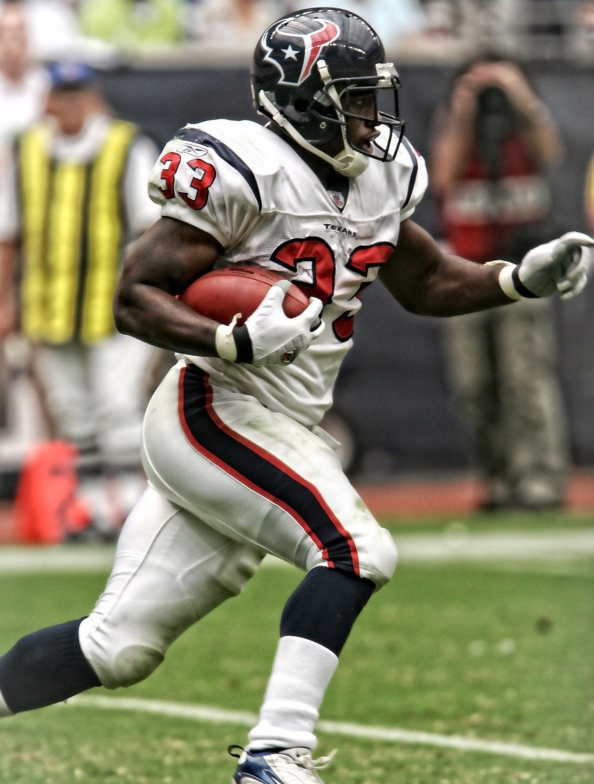
What is speed?
Speed is the ability to move all or part of the body as quickly as possible.
Speed is important in sprinting, cycling and sports such as tennis when a player has to move forward quickly from the baseline to reach a drop shot close to the net.
What sports require straight line speed?
How do you calculate speed? (What is the formula?)
Watch me

Slide 12
Straight line sprints
Task: Find a space in a nearby outdoor space (use a park, driveway or garden)
Using a timer record x10 10m sprints.
How can you increase your linear speed?
Can you experiment with different starting positions? What is the effect on your time?

Slide 13
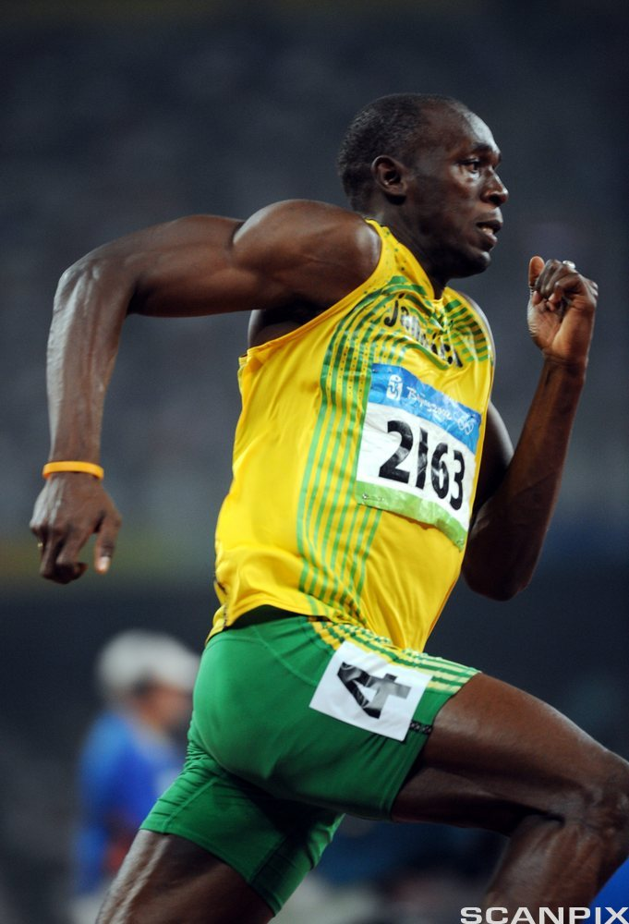
What athletes do it best?
What athletes are known for their speed?
Can you name the athlete shown here?

Slide 14
Practical – Speed Circuit
This practical can be done anywhere with a little bit of space around you.
It will work on your speed
Repeat the circuit 5 times with a 2-minute rest between each set.
Station | Repetitions
High Knees on the spot | 30 seconds
Lateral shuffle + touch | 10 touches each side
Running against a wall | 30 seconds
Foot Fire | 30 seconds
Challenge yourself to increase the time at each station. Why not try 40 or 45 seconds!

Slide 15
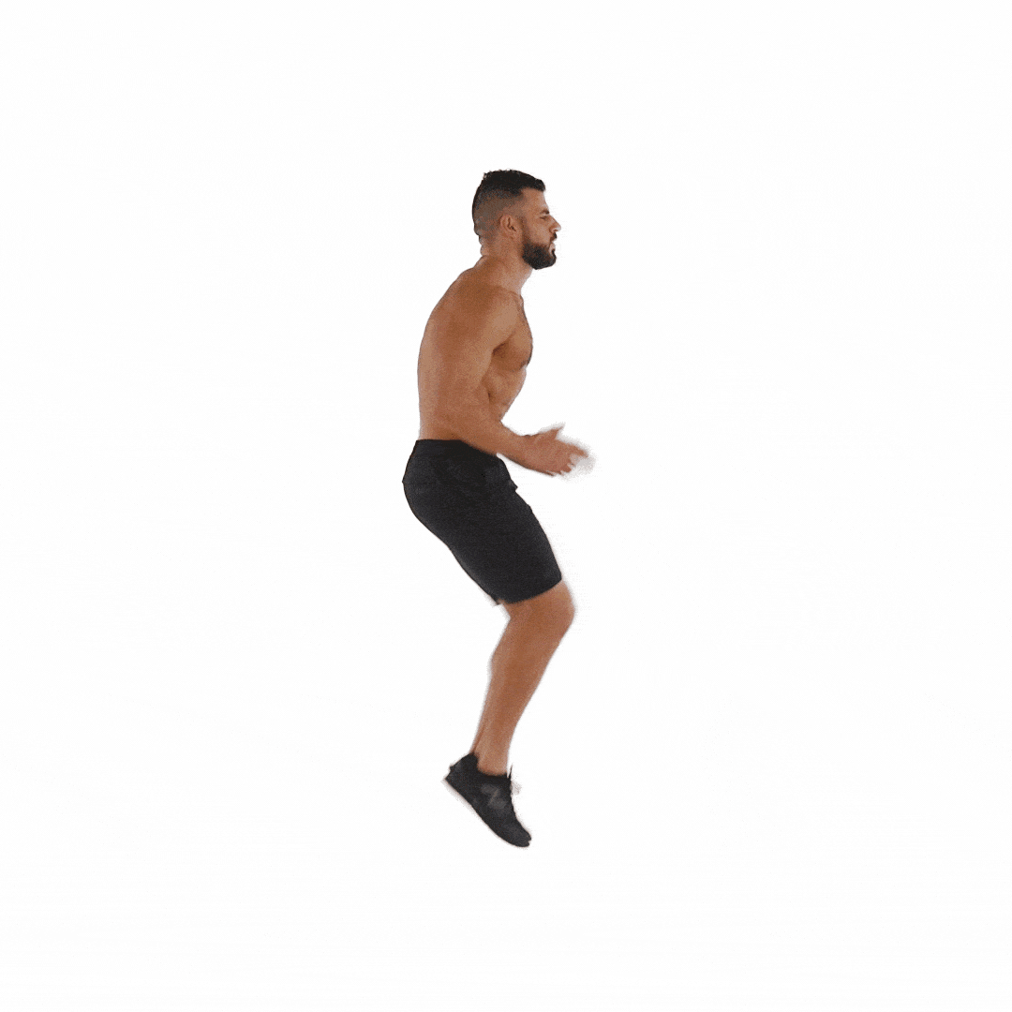
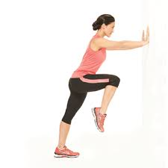
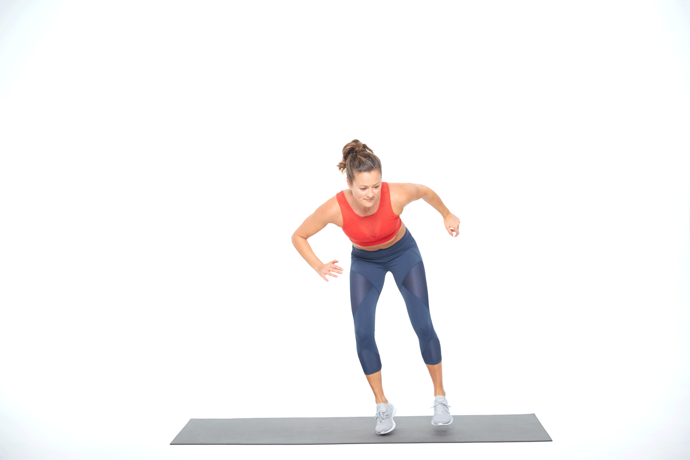
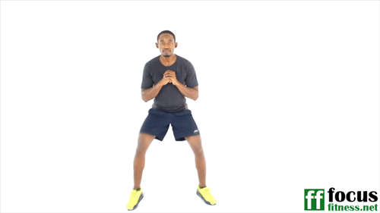
1
3
Ready, Set, Go!
2
4

Slide 16
Plenary
How would you describe speed and what sports rely on this component heavily?
How did you find the speed circuit?

Slide 17
Fitness
Lesson 3 – Agility
This Photo by Unknown Author is licensed under CC BY-NC

Slide 18
Do Now – Chat and Interact
How many muscles are in the human body?
Write your answer in the chat facility NOW!

Slide 19
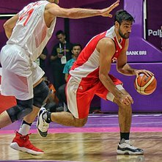
What is agility?
This is the ability to quickly change body position or direction of the body.
Agility is one of the main fitness components important for success in many team sports.
What sports require agility to perform effectively?
How can you measure agility?

Slide 20
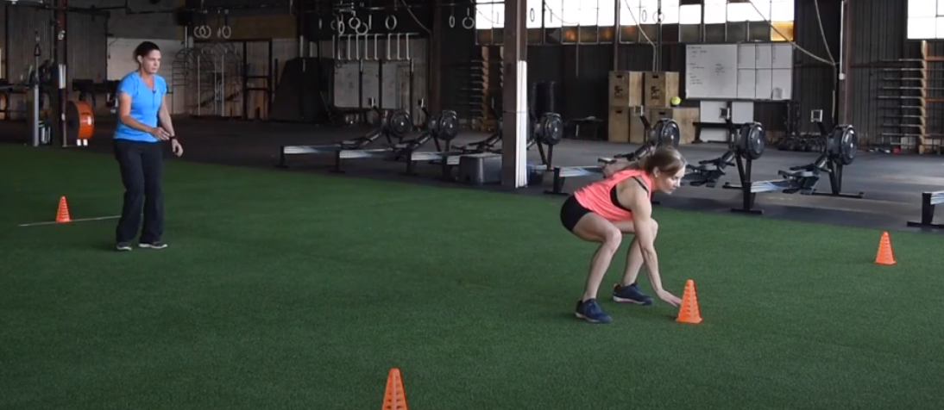
Measuring agility – T test
Task: Find a space in a nearby outdoor space (use a park, driveway or garden)
Set up a ‘T’ with 4 objects. Complete x5 and record times.
Watch me
How will keeping a lower centre of gravity help achieve a faster time?

Slide 21
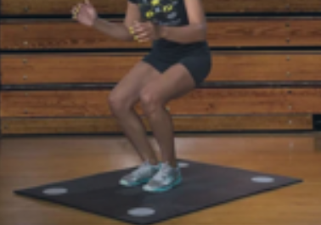
Movement drill
Task: Find a space inside and mark out 4 targets (use a piece of paper – label them 1-4)
Use a partner to call out a number and shuffle to that marker as quick as possible.
Use a combination of calls to sequence movements.
How can you make this harder?
Can you incorporate a coordination or reaction time element?

Slide 22
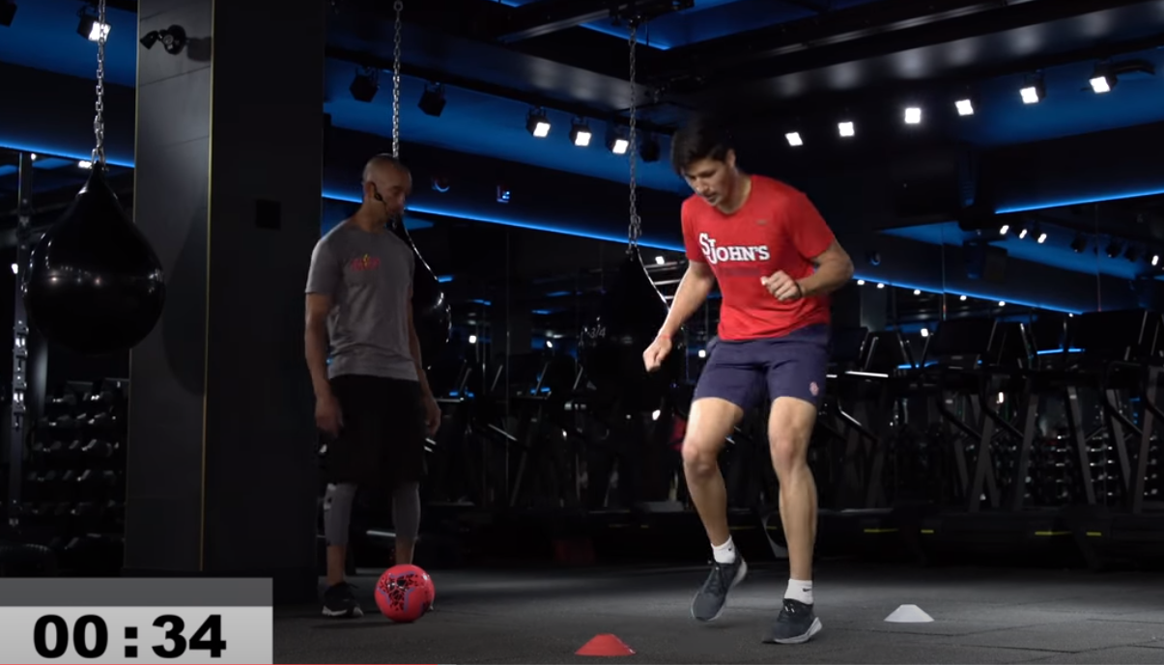
Practical – Agility Workout
This practical can be done anywhere with a little bit of space around you.
It will be a series of exercises in a 30-minute workout.
Have your water ready!

Slide 23
Ready, Set, Go!

Slide 24
Plenary
What is agility and how does it feature in sport?
How will this improve a basketballers performance?
How did you find the agility workout?

Slide 25
Fitness
Lesson 4 – Power
This Photo by Unknown Author is licensed under CC BY-NC

Slide 26
Do Now – Chat and Interact
What is the average number of steps a person in the UK takes?
Write your answer in the chat facility NOW!

Slide 27
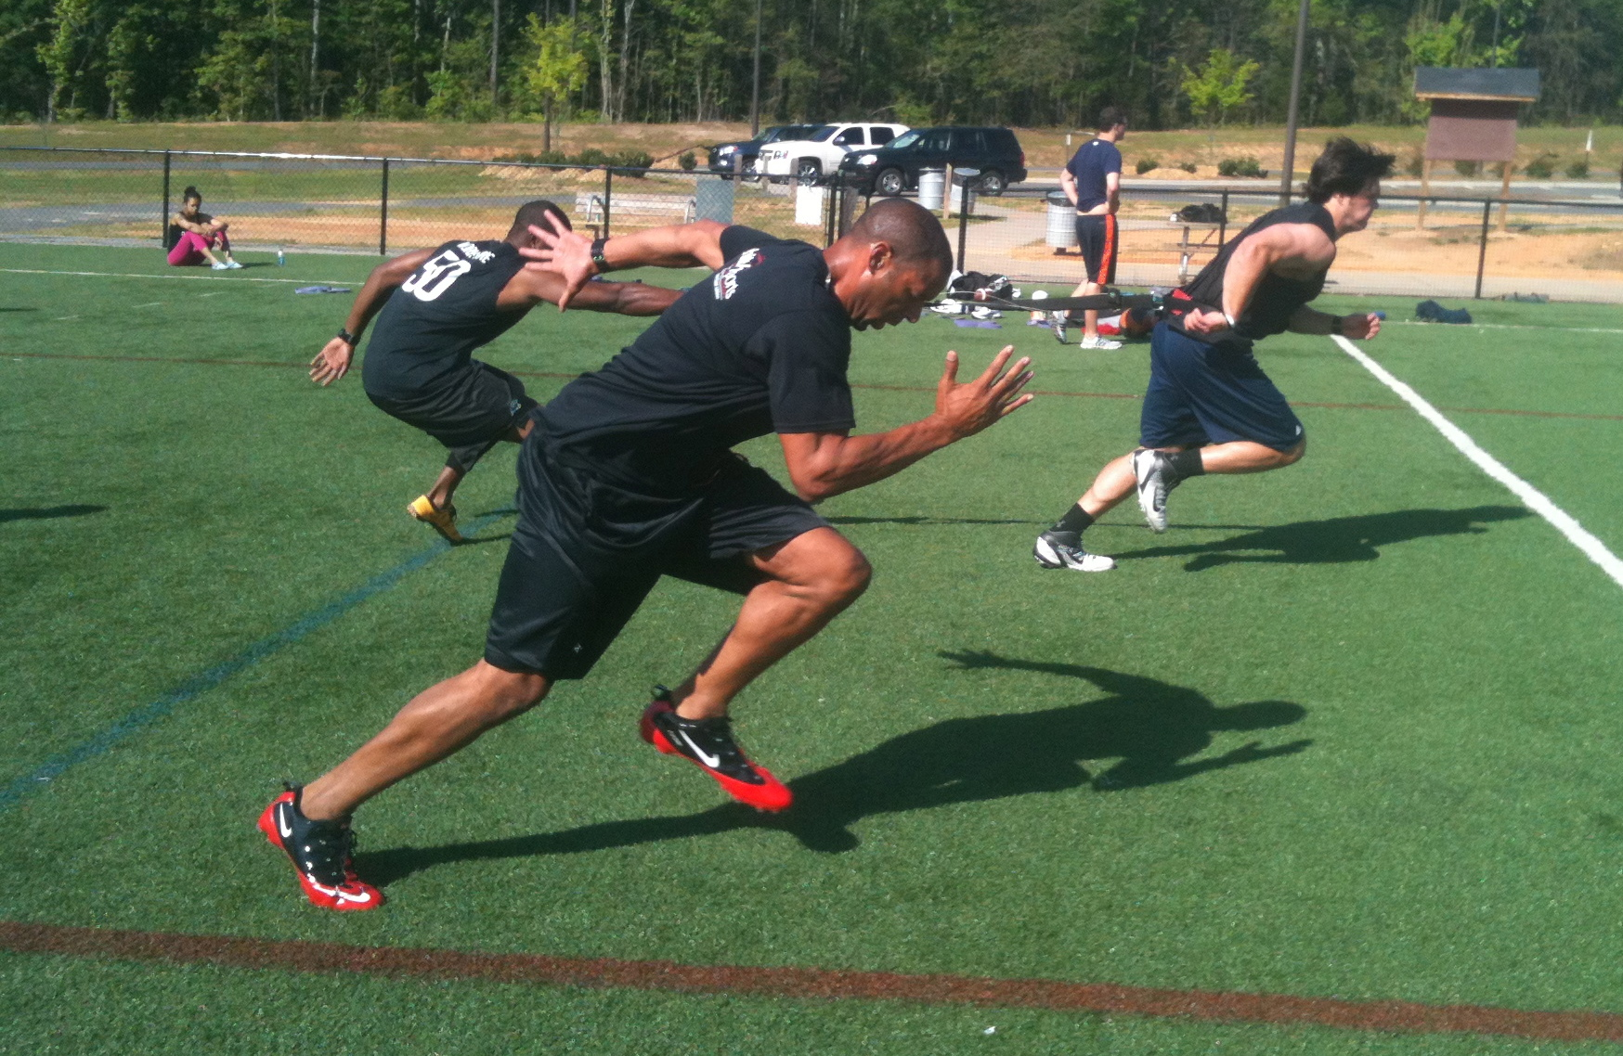
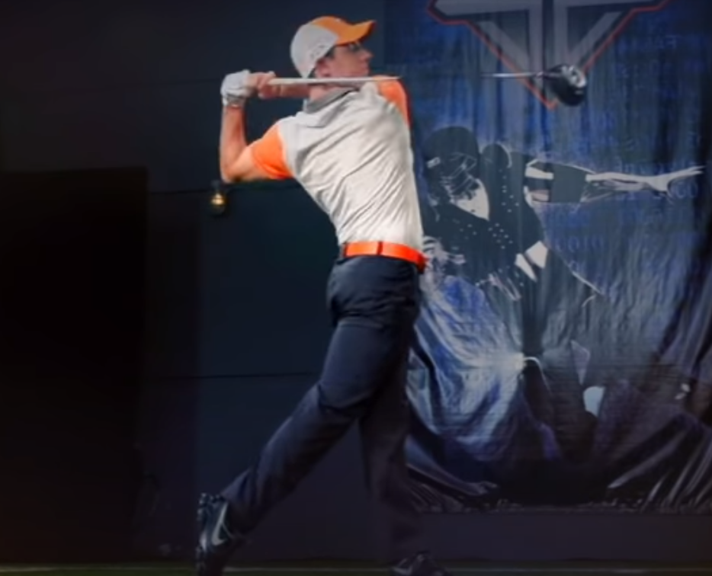
What is Power?
This is the ability to exert maximum muscular contraction instantly in an explosive burst of movements. The two components of power are strength and speed.
How does golfer use power?
Watch me

Slide 28
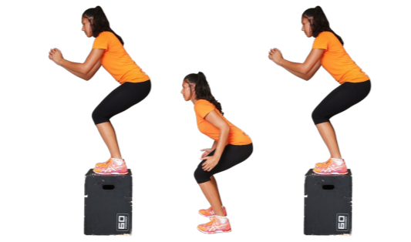
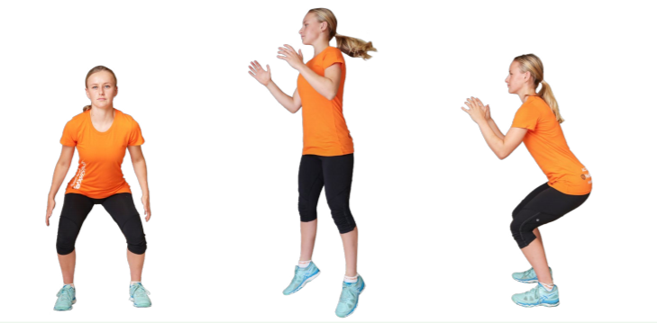
Jumping and Landing
Task: Using the space around you complete 10 jumps of each exercise to work on your power.
Repeat x5 times.
1
3
2
These activities can be done with a step or a box and one footed or two.

Slide 29
Practical – Lower body workout
This practical can be done anywhere with a little bit of space around you.
It will work on your lower body
Each time you go all the way through the workout it counts as 1 circuit.
How many full circuits can you do in 10 mins?
Exercise | Repetitions
Squats | 12
Burpee | 6
Jump Squats | 15
Alternate Lunges | 8 each side
Wall Sit | 30 Seconds
Step ups | 20

Slide 30
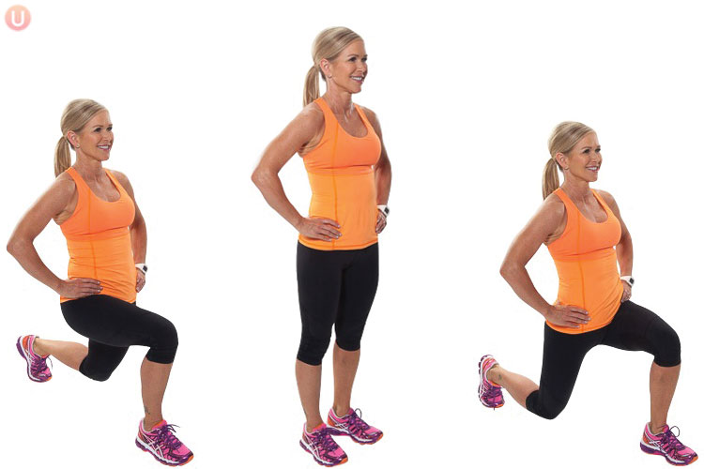
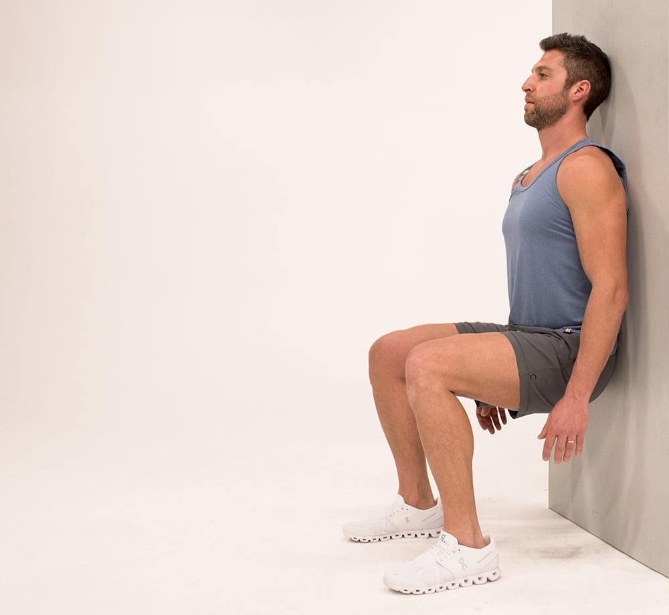
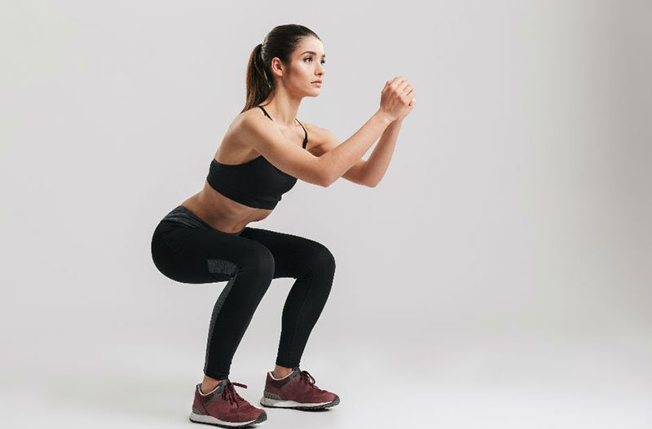
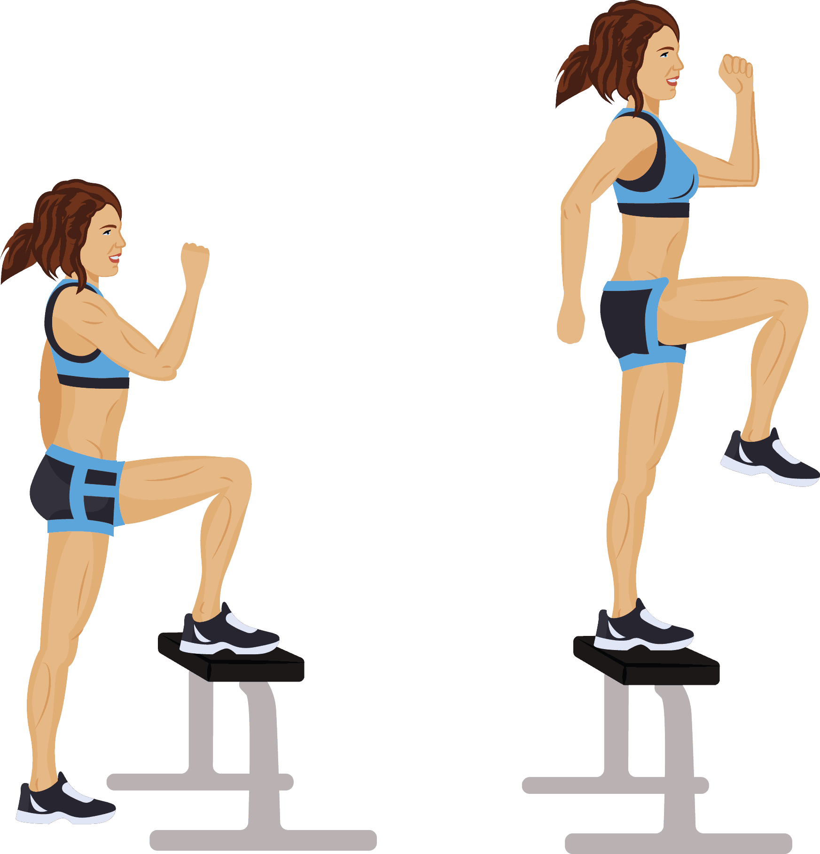
1
4
2
5
Ready, Set, Go!
3
6

Slide 31
Plenary
What is the definition of power?
How will power benefit performance of a gymnast?
How did you find the lower body workout?

Slide 32
Fitness
Lesson 4 – Cardiovascular Endurance
This Photo by Unknown Author is licensed under CC BY-NC

Slide 33
Do Now – Chat and Interact
On average, how many times does the heart beat in a day?
Write your answer in the chat facility NOW!

Slide 34
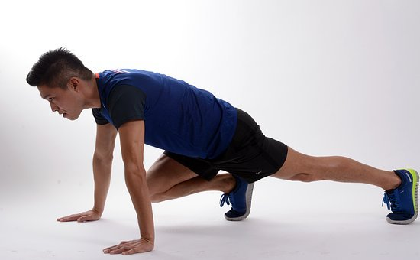
High Intensity Interval Training
HIIT workouts shift your body from periods of aerobic activity to periods of anaerobic activity. When your body is in “aerobic mode,” your body is using oxygen. When your body is in “anaerobic mode,” your body is using its stored energy instead of oxygen.
These workouts typically last under 30 minutes due to their high intensity nature.
What are the risks associated with HIIT training?
How can it be made easier or harder?

Slide 35
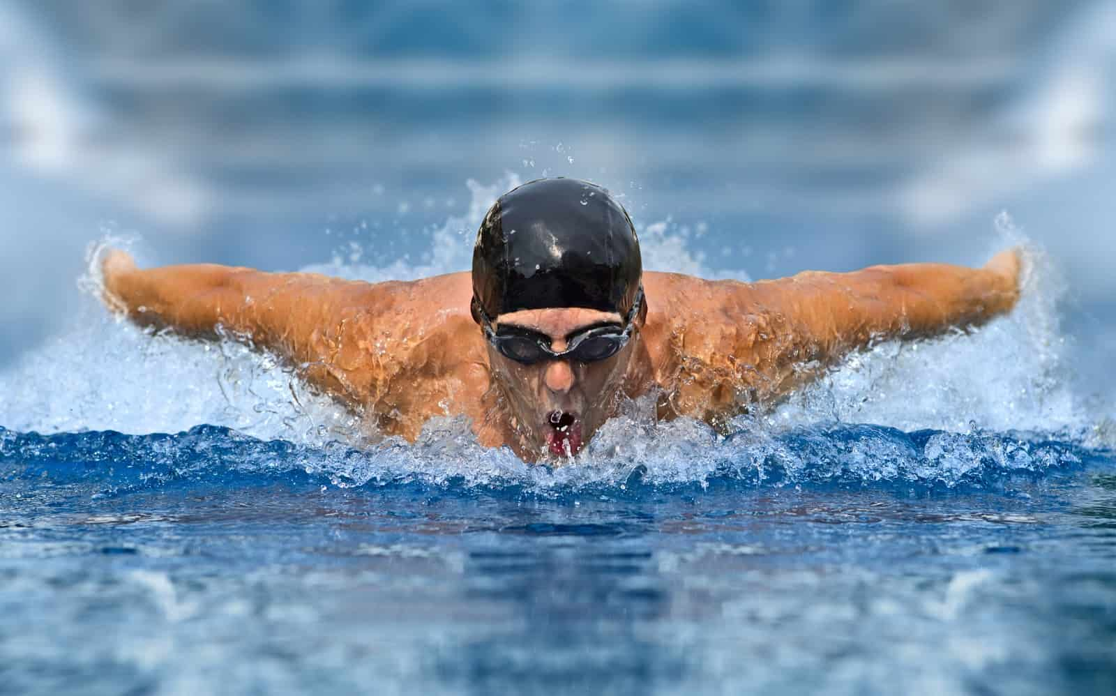
Cardiovascular Endurance
Cardiovascular endurance is how efficiently your heart, blood vessels, and lungs to supply oxygen rich blood to working muscles during physical activity (aerobic activity like walking, running, cycling or playing a sport) for a prolonged period of time or for more than 90 seconds.
What sports require a high level of cardiovascular endurance?
Watch me

Slide 36
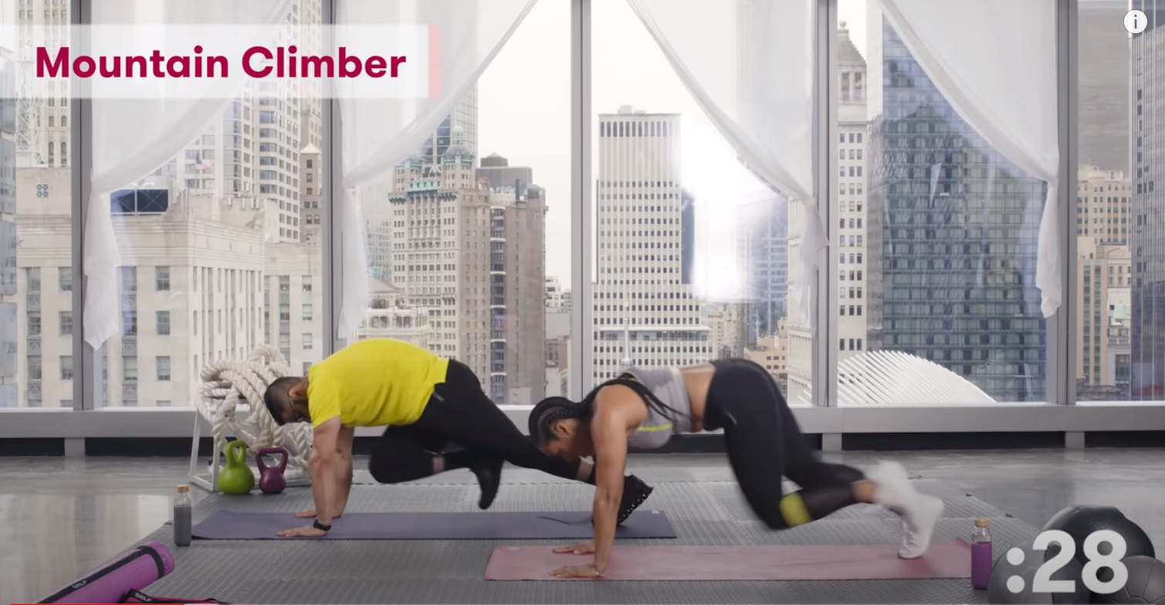
Practical – HIIT Workout
This practical can be done anywhere with a little bit of space around you.
It will be a series of intense exercises for 30 seconds.
Have your water ready!

Slide 37
Ready, Set, Go!

Slide 38
Plenary
What sports require a high level of cardiovascular endurance?
How did you find the HIIT session?
Who might this type of training be suitable for?

